Slide 1
SC cybersecurity
Databricks Enablement Workshop
Day 2 (Workshop 3)
Ankur Khosla, ankur.khosla@databricks.com
Resident SA, ASEAN
‹#›

Slide 2
Day 2 Agenda
Workshop 3 (2 hrs):
ETL
Medallion Layer Architecture
Deep dive into ETL
Data pipeline Deep Dive :
DLT
Autoloader
Workflow

Slide 3
Housekeeping
Voice out to Accelerate when:
Too simple/Already know it
Needs deeper content
Ask questions during workshop

Slide 4
Housekeeping
Expected Outcome of Day 2:
Clear understanding of Databricks Medallion Architecture using ETL via Notebook(SQL/Python) + Delta Live Tables
DLT Monitoring
Data Quality
Lineage
Rerun/Full Refresh
High level Understanding of following ETL concepts
Change data capture
Version Control
Rollback
Optimization
Vacuum.
Autoloader
Incremental
Event Based
Workflow :
Monitoring
History Audit
Rerun dependency Tasks

Slide 5
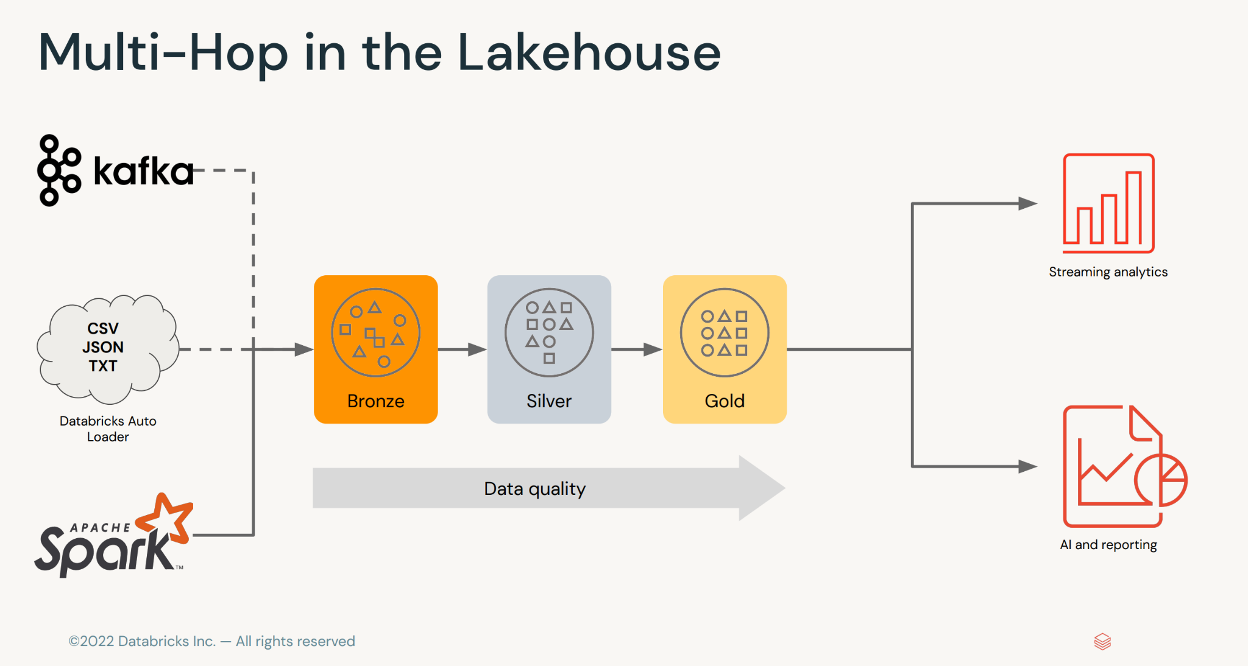
Medallion Architecture / Multi Hop Architecture

Slide 6
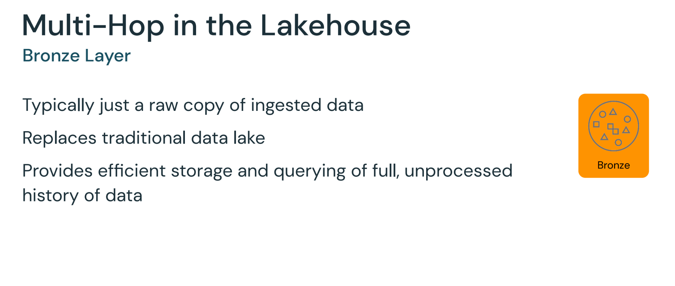
Medallion Architecture / Bronze Layer

Slide 7
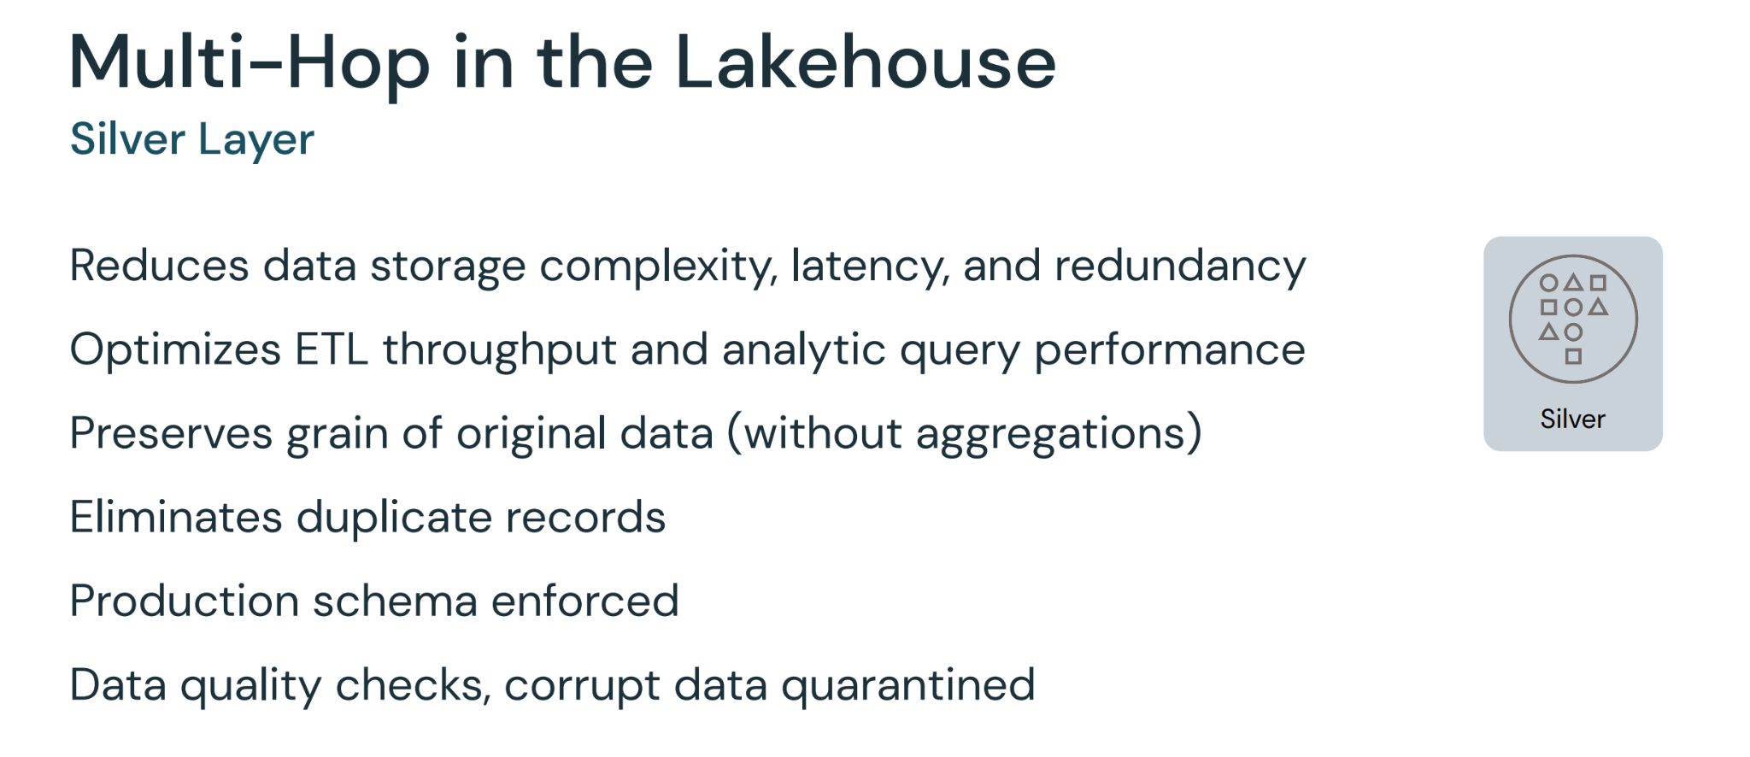
Medallion Architecture / Silver Layer

Slide 8
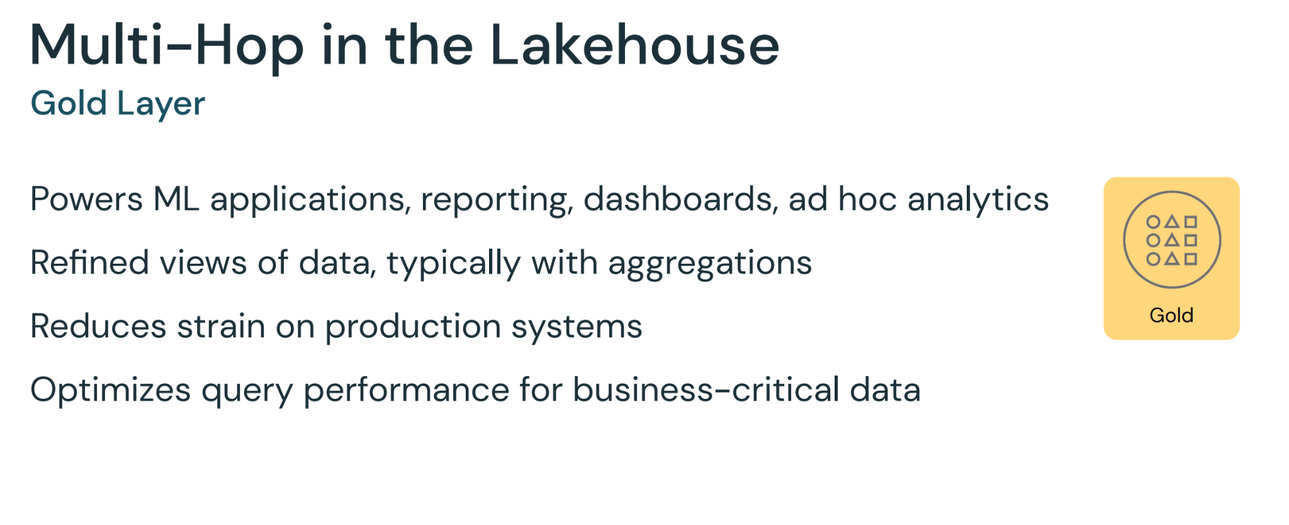
Medallion Architecture / Gold Layer

Slide 9
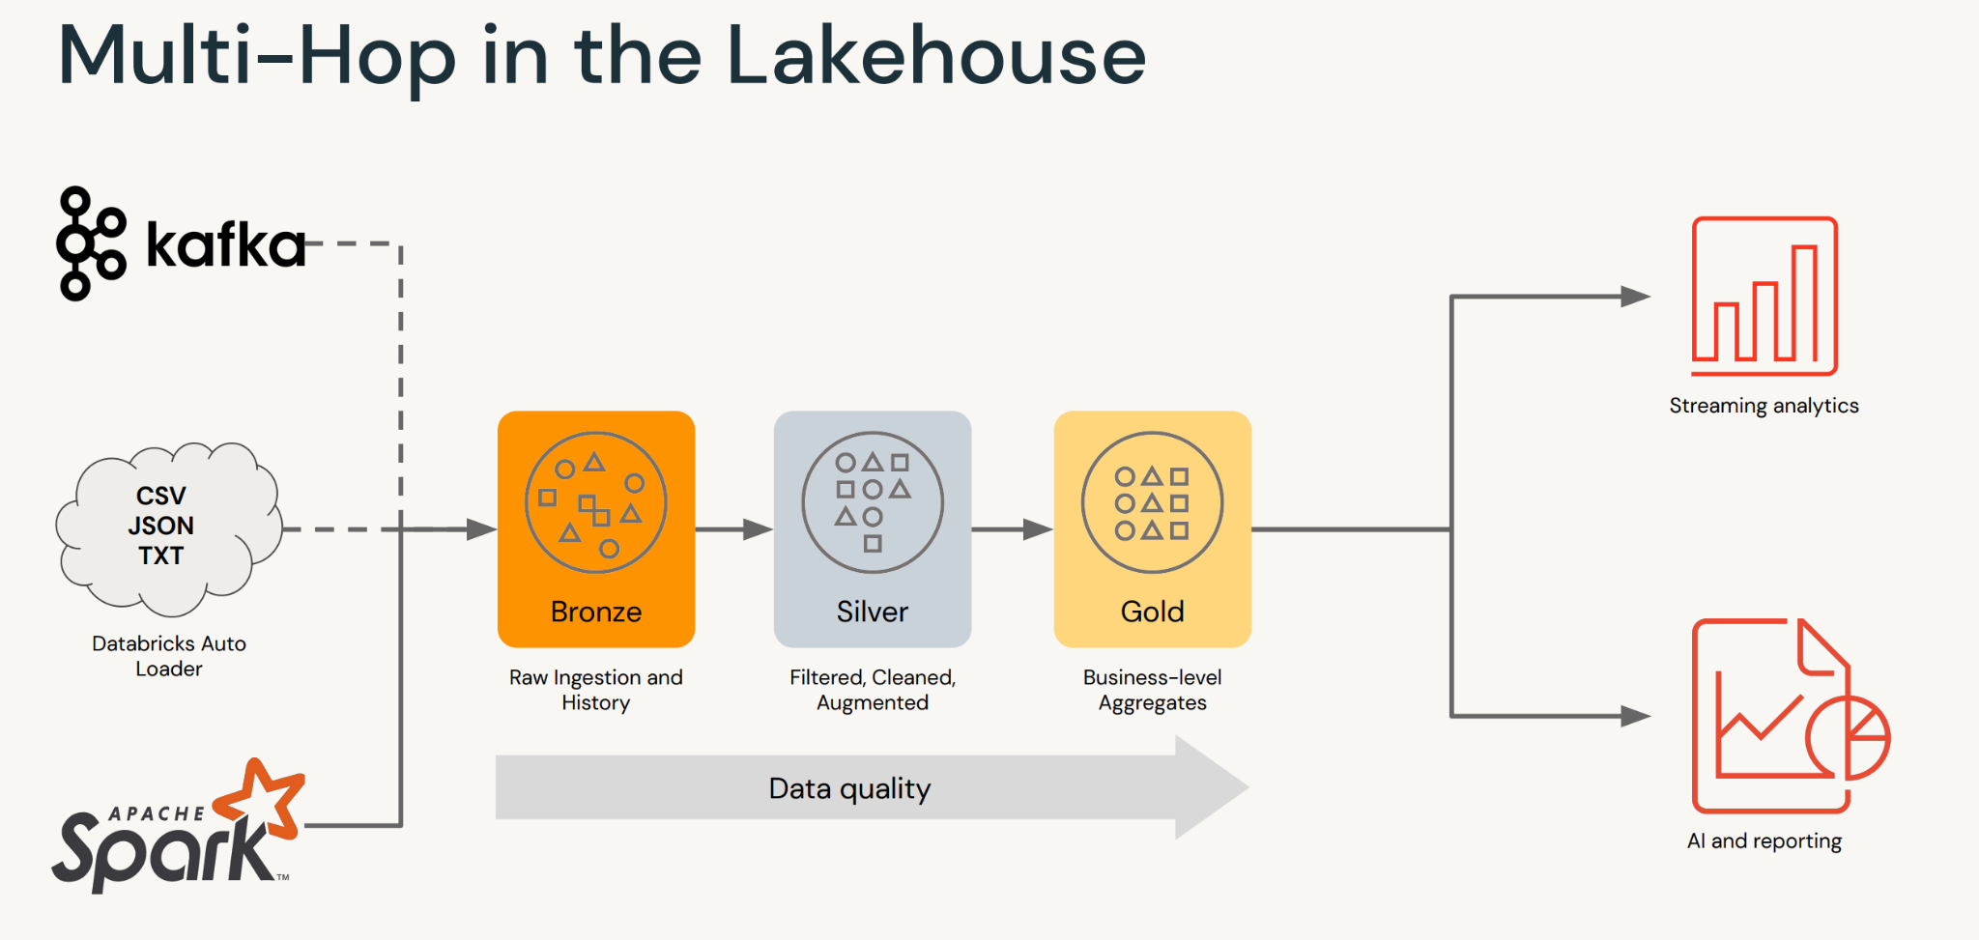
Delta Live Tables

Slide 10



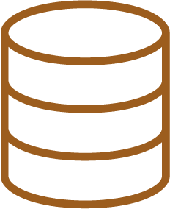

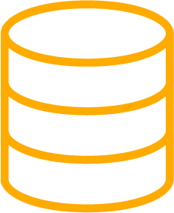




But the reality is not so simple
Maintaining data quality and reliability at scale is often complex and brittle
Streaming Analytics
Kinesis
CSV,
JSON, TXT…
BI & Reporting
Data Lake
Data Science & ML

Slide 11
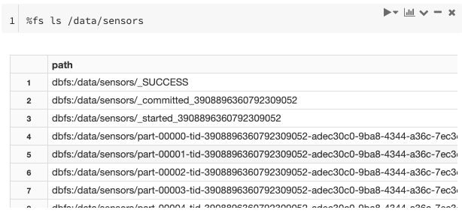
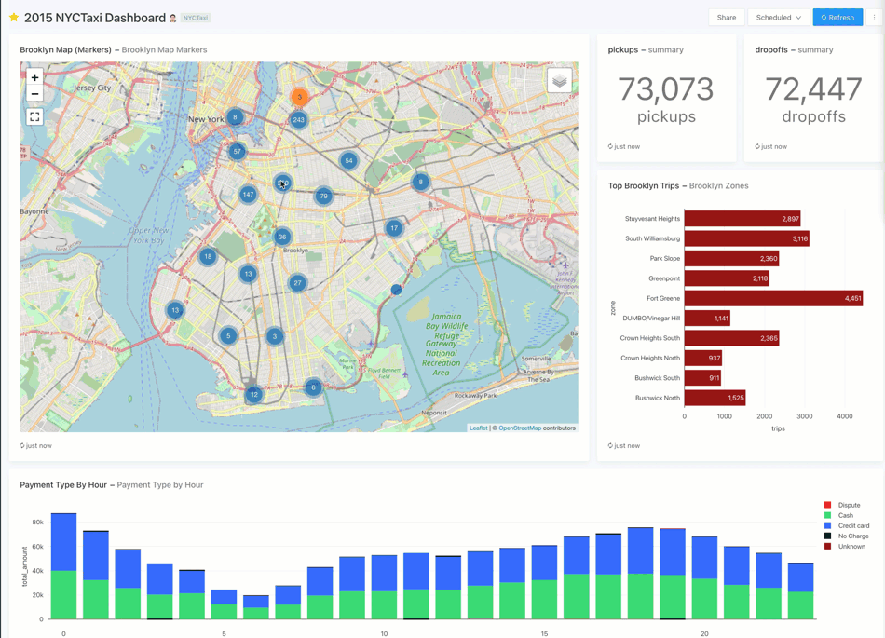
Life as a data professional…
From: The CEO <ali@databricks.com> Subject: Need an analysis ASAP! To: Michael Armbrust <michael@databrick.com>
Hey Michael, I need a quick analysis of our net customer retention and how it has changed over the past few quarters. Raw data can be found at s3://our-data-bucket/raw_data/...
???

Slide 12
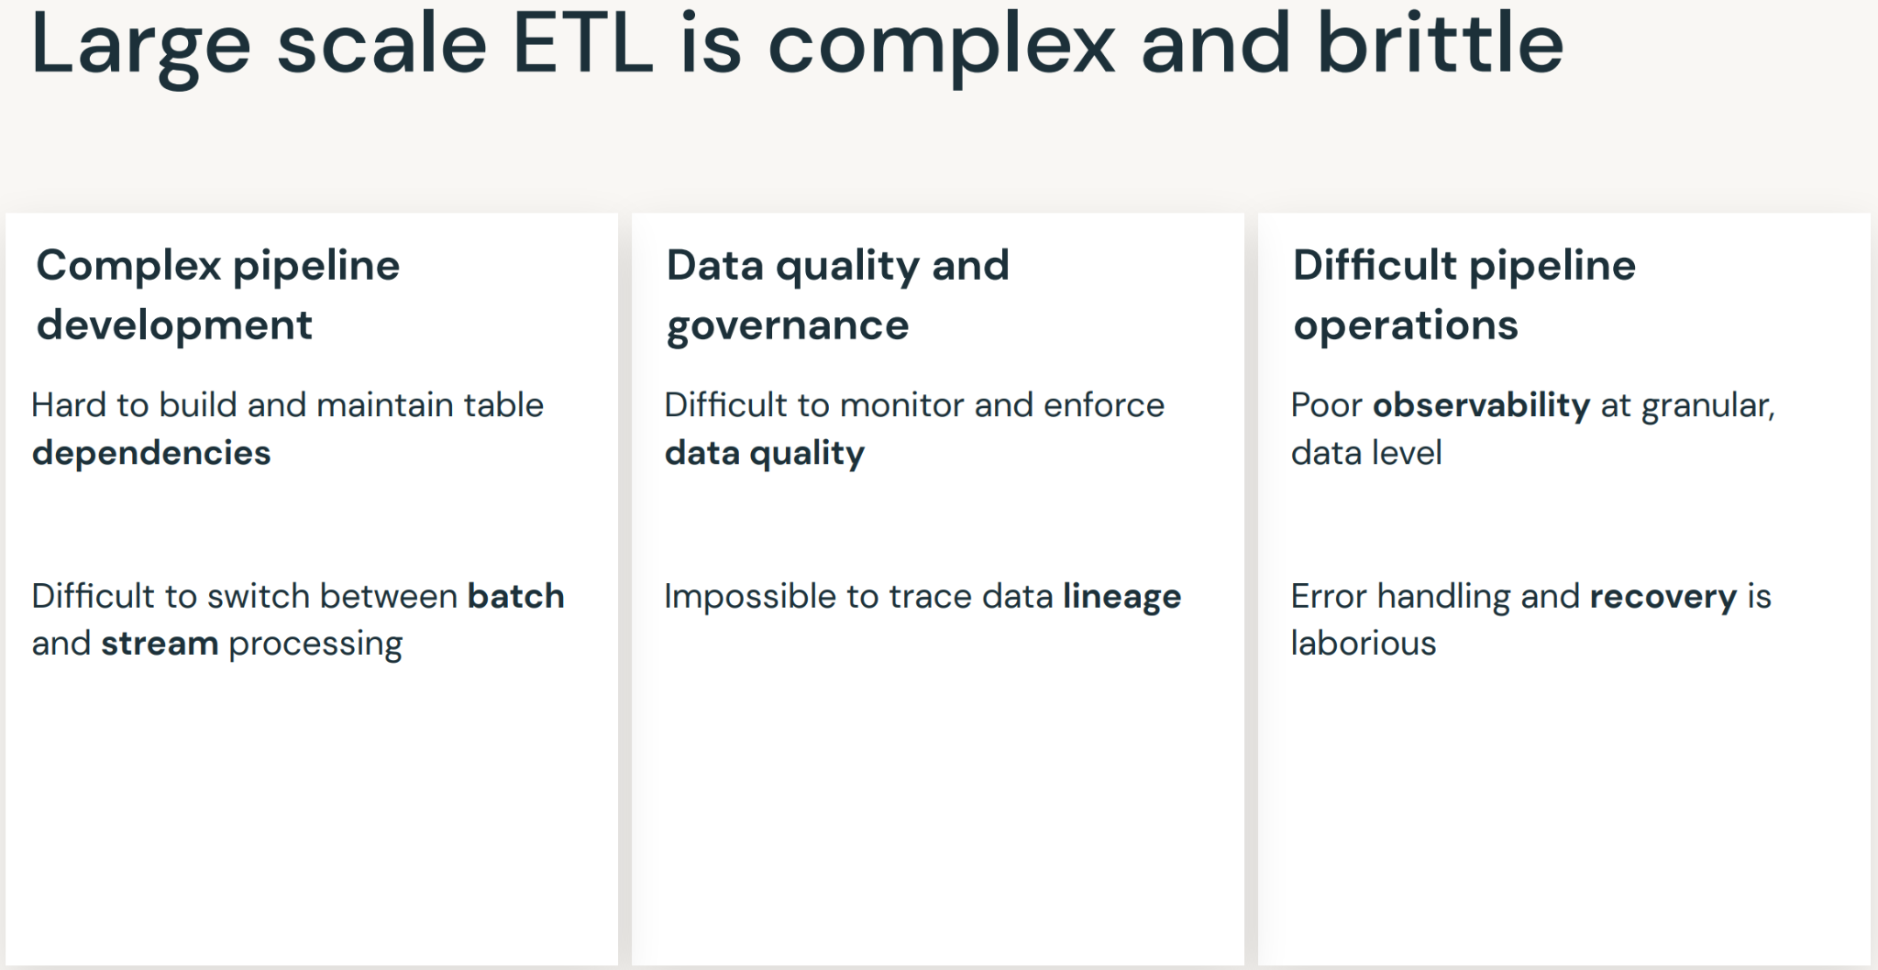
Delta Live Tables

Slide 13
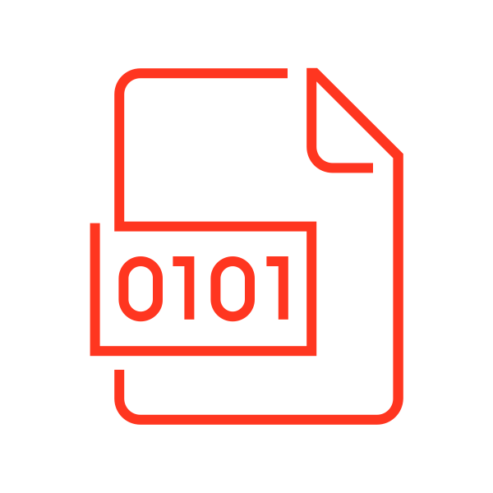





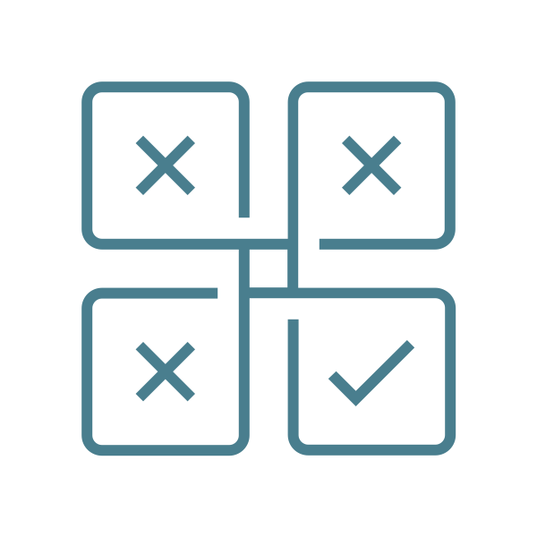



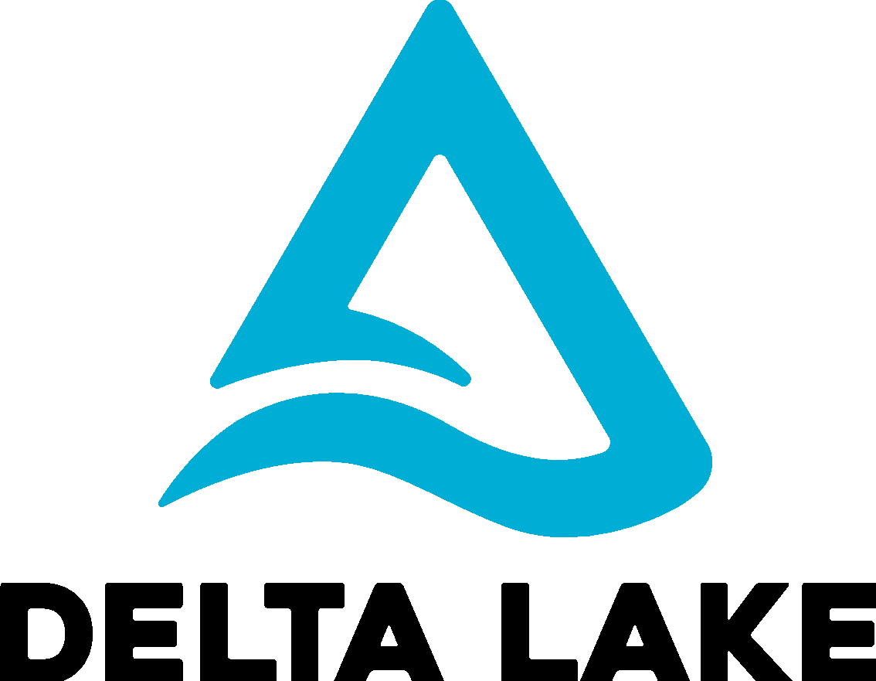
The slog from query to production
The tedious work required to turn SQL queries into reliable ETL Pipelines
Version Control
Deployment Infrastructure
Backfill Handling
Quality Checks
Governance
Data Discovery
Dependency
Management
CREATE TABLE raw_data as SELECT * FROM json.`…`
Daily Partition
Computation
Checkpointing
& Retries
CREATE TABLE clean_data as SELECT … FROM raw_data

Slide 14
Operational complexity dominates
Time is spent on tooling instead of on transforming
Version Control
Deployment Infrastructure
Backfill Handling
Quality Checks
Governance
Data Discovery
Dependency
Management
CREATE TABLE raw_data as SELECT * FROM json.`…`
Daily Partition
Computation
Checkpointing
& Retries
CREATE TABLE clean_data as SELECT … FROM raw_data

Slide 15
Where you should focus your time
Getting value from data
Version Control
Deployment Infrastructure
Backfill Handling
Quality Checks
Governance
Data Discovery
Dependency
Management
CREATE TABLE raw_data as SELECT * FROM json.`…`
Daily Partition
Computation
Checkpointing
& Retries
CREATE TABLE clean_data as SELECT … FROM raw_data

Slide 16
Introducing Delta Live Tables
From query to production pipeline just by adding LIVE.
CREATE LIVE TABLE raw_data as SELECT * FROM json.`…`
CREATE LIVE TABLE clean_data as SELECT … FROM LIVE.raw_data
Repos
Unity Catalog*
Databricks Workflows
Delta Live Tables
Full Refresh
Dependency
Management
Expectations
Incremental
Computation*
Checkpointing
& Retries
* Coming Soon

Slide 17
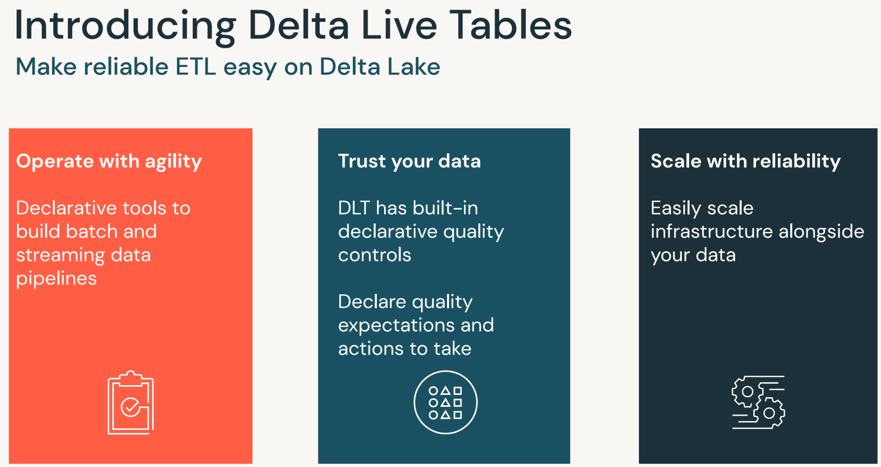
Delta Live Tables

Slide 18
Automated Data Management
DLT automatically optimizes data for performance & ease-of-use
Best Practices
Physical Data
Schema Evolution
What:
DLT encodes Delta best practices automatically when creating DLT tables.
How:
DLT sets the following properties:
optimizeWrite
autoCompact
tuneFileSizesForRewrites
What:
DLT automatically manages your physical data to minimize cost and optimize performance.
How:
runs vacuum daily
runs optimize daily
You still can tell us how you want it organized (ie ZORDER)
What:
Schema evolution is handled for you
How:
Modifying a live table transformation to add/remove/rename a column will automatically do the right thing.
When removing a column in a streaming live table, old values are preserved.

Slide 19
Workshop -Medallion ( Notebook + DLT) (15 min)
Notes:
Tag:azure,aws,gcp

Slide 20
Databricks CDC/CDF with Delta Lake and DLT pipeline
Notes:
Today’s session is about Delta Lake and how it is the right foundation for your lakehouse

Slide 21





Streamline operations with Delta Lake
Improve ETL pipelines
Simplify data pipelines through streamlined development, improved data reliability, and cloud-scale production operations.
Read more
Unify batch and streaming
With direct integration to Apache Spark™ Structured Streaming, run both batch and streaming operations on one architecture.
Read more
BI on your data lake
Enable analytics directly on your data lake with the most complete and freshest set of data.
Read more
Meet regulatory needs
Meet compliance standards like GDPR and CCPA and keep a record of historical data changes.
Read more
Delta Change Data Feed
Notes:
Key Points:
Scalable ETL and ELT with enhanced data reliability to overcome traditional data lake limitations
Common processing of batch and streaming in the same job and with the same simple architecture
Analyze up-to-date information in BI and visualizations while maintaining cost efficiency and performance
Capturing and tagging data necessary for regulatory compliance and audit
Change Data Feed (build)
Delta Change Data Feed supports all of these common use cases - let’s dig in to how

Slide 22



Current Challenges
Identifying Changes
Updating BI & Analytics Data
Producing an Audit Trail
Updates in ETL struggle to find changes in the data from version to version in large tables
Without information regarding the specific changes to be made, all data must be compared
Real-time updates to BI and analytics require additional processing as changes arrive
Recalculating full datasets causes downtime to users incompatible with real-time needs
Audits of records, en masse or individually, demand the ability to readily construct data as it was at any or every point in time
Digging through all versions is impractical yet required to meet compliance requirements

Slide 23
What Delta Change Data Feed Does for You
Improve ETL pipelines
Process less data during ETL to increase efficiency of your pipelines
Unify batch and streaming
Common change format for batch and streaming updates, appends, and deletes
BI on your data lake
Incrementally update the data supporting your BI tool of choice
Meet regulatory needs
Full history available of changes made to the data, including deleted information
Delta Change Data Feed
Notes:
Key Points:
Delta Change Data Feed allows for less data to be replicated or touched when processing updates, dramatically reducing the time needed to make changes
Batch and streaming sources converge into the same format of change logs in Delta Change Data Feed for unified, efficient downstream processing
The cleansed and aggregated data used for BI, visualizations, and analytics is updated incrementally - giving analysts access to trusted, governed data as changes come in rather than having to wait for daily jobs
For even faster updates to BI tooling, use materialized views based upon Delta Change Data Feed
Audit and regulatory compliance often need to what changes have been made to data over time. Delta Change Data Feed provides traceability back through the history of individual records and values to ensure that historical updates are available.

Slide 24
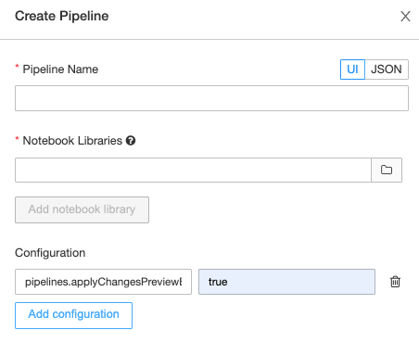
Getting started with Change Data Capture in DLT
Enable DLT APPLY CHANGES INTO in DLT Pipeline
"configuration": {
"pipelines.applyChangesPreviewEnabled": "true"
}

Slide 25
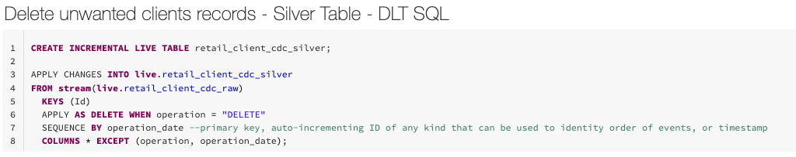
Getting started with Change Data Capture in DLT
APPLY CHANGES INTO to propagate inserts, updates and deletes to your target table.
Specifies when a CDC event should be treated as a DELETE rather than an upsert.
To remove columns needed for APPLY CHANGES INTO computation, but not needed in final table state.
Notes:
https://databricks.com/discover/getting-started-with-delta-lake-tech-talks

Slide 26

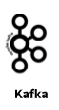


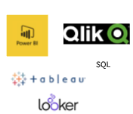

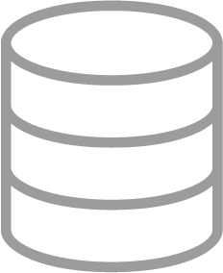

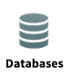
Where Delta Change Data Feed Applies
BRONZE
SILVER
GOLD
Raw Ingestion and History
Filtered, Cleaned, Augmented
Business-level Aggregates
External feeds, Other CDC output,
Extracts
CDF
Notes:
Delta Change Data Feed is an output from Delta Lake. This means that CDF applies when processing from a Delta format to a further step in the data flow.
In order to take advantage of the Delta Change Data Feed, simply bring in your external data sources to the Bronze layer, as previously done, and then enable CDF from that point forward.
This will allow you to use the Change Data Feed in moving to the Silver or Gold layers or feeding out to an external platform.

Slide 27
How Does Delta Change Data Feed Work?
Original Table (v1)
Change data
(Merged as v2)
Change Data Feed Output
PK | B | Change Type | Time | Version
A2 | B2 | Preimage | 12:00:00 | 2
A2 | Z2 | Postimage | 12:00:00 | 2
A3 | B3 | Delete | 12:00:00 | 2
A4 | B4 | Insert | 12:00:00 | 2
 | PK | B
 | A1 | B1
 | A2 | B2
 | A3 | B3
 | PK | B
 | A2 | Z2
 | A3 | B3
 | A4 | B4
A1 record did not receive an update or delete.
So it will not be output by CDF.
Notes:
We start with the original table, which has three records (A1 through A3) and two fields (PK and B)
(Click to build)
We then receive an updated version of this table that shows a change to field B in record A2, removal of record A3, and the addition of record A4
(Click to build)
As this gets processed, the Delta Change Data Feed captures only records for which there was a change. This is what allows Delta Change Data Feed to speed up ETL pipelines as less data is being touched.
Note that record A1 is not reflected in the Change Data Feed output as no changes were made to that record.
In the case of updates, the output contains what the record looked like prior to the change, called the preimage, and what it held after the change, called the postimage. This can be particularly helpful when producing aggregated facts or materialized views as appropriate updates could be made to individual records without having to reprocess all of the data underlying the table. This allows changes to be reflected more quickly in the data used for BI and visualization.
For deletes and inserts, the affected record is shown with an indication of whether it is being added or removed.
Additionally, the Delta version is noted so that logs are maintained of what happened to the data when. This allows greater granularity for regulatory and audit purposes as needed. We do capture the timestamp of these commits as well and will show this in a few minutes.
While this depicts a batch process, the source of updates could just as easily by a stream instead. The Change Data Feed output would be the same.

Slide 28
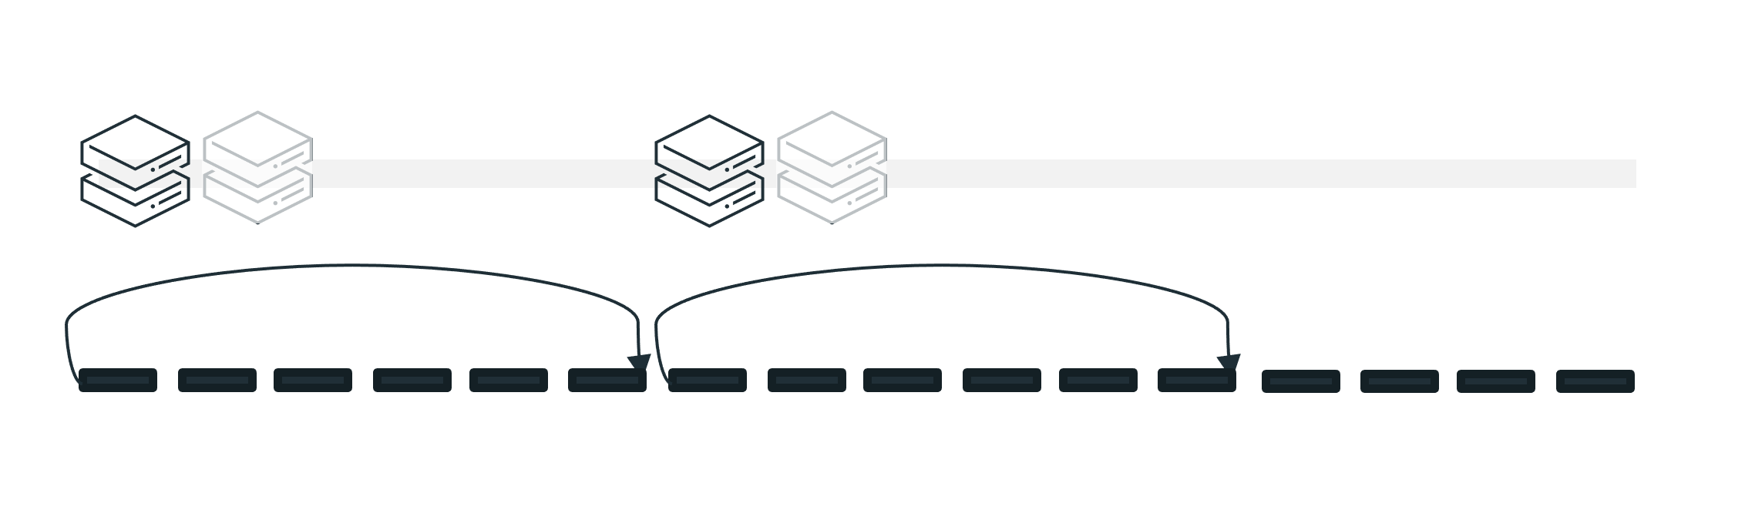
Consuming the Delta Change Data Feed
Stream-based Consumption
Delta Change Feed is processed as each source commit completes
Rapid source commits can result in multiple Delta versions being included in a single micro-batch
Stream - micro batches
12:00
12:08
12:10:10
A2 | B2 | Preimage | 12:00:00 | 2
A2 | Z2 | Postimage | 12:00:00 | 2
A3 | B3 | Delete | 12:00:00 | 2
A4 | B4 | Insert | 12:00:00 | 2
A5 | B5 | Insert | 12:08:00 | 3
A6 | B6 | Insert | 12:09:00 | 4
A6 | B6 | Preimage | 12:10:05 | 5
A6 | Z6 | Postimage | 12:10:05 | 5
12:00
A5 | B5 | Insert | 12:08:00 | 3
A6 | B6 | Insert | 12:09:00 | 4
A6 | B6 | Preimage | 12:10:05 | 5
A6 | Z6 | Postimage | 12:10:05 | 5
Batch Consumption
Batches are constructed based in time-bound windows which may contain multiple Delta versions
12:10:00
12:20
Batch - every 10 mins
Notes:
There are two ways to consume the Delta Change Data Feed in downstream processing - stream and batch.
Stream Mode
In stream mode, you use Delta structured streaming to process the Delta Change Feed as it comes in. This pattern allows for micro-batches to be consumed based upon the latest checkpoint without waiting for a predetermined time interval. The stream will simply process whatever has come in since the last checkpoint.
In the timeline shown here, let us assume that the large upsert from our previous example comes through at 12:00.
Our next insert (Delta version 3) commits at 12:08. The stream has already completed processing the first group and immediately picks up our 12:08 insert. It does not have to wait for a scheduled point in time to kick off.
We then receive the insert for Delta version 4 as 12:09. The stream process for the last commit has not yet completed.
Delta version 5, an update to the same record as was inserted in Delta version 4, comes in at 12:10:05. As soon as the prior stream micro-batch completes, the next kicks off and picks up Delta versions 4 and 5.
An important note here is that this does function as a micro-batch in that you now have both an insert and an update to a record in the same batch. You must add handling for choosing the latest data to insert from this batch.
Batch Mode
In batch mode, the processing of the Delta Change Feed is set to occur every X minutes. You must then add logic to handle identifying the current high water mark (the latest Delta version or timestamp previously processed) and picking up any changes from that point forward.
Following our example from before, let us assume that this batch process has been set to run every 10 minutes. When it kicks off at 12:00, it processes the large upsert.
There is a pause until 12:10, when the process kicks off again, establishes that the high water mark is Delta version 2, and picks up everything since then. In this case, it has both version 3 and version 4 to include.
The batch then pauses again and does not pick up version 5 until 12:20 despite it arriving shortly after the last batch was triggered.

Slide 29
Typical Use Cases
Silver & Gold Tables
Materialized Views
Transmit Changes
Audit Trail Table
Improve Delta performance by processing only changes following initial MERGE comparison to accelerate and simplify ETL/ELT operations
Create up-to-date, aggregated views of information for use in BI and analytics without having to reprocess the full underlying tables, instead updating only where changes have come through
Send Change Data Feed to downstream systems such as Kafka or RDBMS that can use it to incrementally process in later stages of data pipelines
Capturing Change Data Feed outputs as a Delta table provides perpetual storage and efficient query capability to see all changes over time, including when deletes occur and what updates were made
Notes:
Silver & Gold Tables
Using Delta Change Data Feed outputs for changes in the Silver and Gold layers ensure that all changes are reflected with substantially less processing cost
Materialized Views
In many cases there’s a need to capture an aggregated view of the gold level data for a dashboard or real-time application. Relying on the change data feed can eliminate the need for costly re-aggregations off of full tables while ensuring that changes are reflected appropriately.
Transmit Changes
Outputting data from Delta to other systems can help solve specific needs and support other applications. For platforms that can ingest Change Data Output, this creates a means of incrementally updating databases, applications, and other systems with minimal overhead.
Audit Trail Table
Compliance and audit typically need to be able to identify when, where, and how data has been changed. Change Data Feed outputs stored in a Delta table provide a quick, queryable means of finding exactly what has happened either to a specific record, to sets of data, or to the entire table.

Slide 30


When to Use Delta Change Data Feed
Delta changes include updates and/or deletes | Delta changes are append only
Small fraction of records updated in each batch | Most records in the table updated in each batch
Data received from external sources is in CDC format | Data received comprises destructive loads
Send data changes to downstream application | Find and ingest data outside of the Lakehouse
Notes:
While all of the benefits sound wonderful, it’s important to acknowledge that Delta Change Feed is not the best solution in every situation. Let’s walk through the best practices as to when to use, and when not to use, Delta Change Data Feed.
If your incoming data contains updates or deletes, Delta Change Data Feed is a good choice. This will help to reduce costly table scans to identify these types of changes downstream. On the other hand, if you only receive appends, Delta Change Feed may not be the best option. In this case, a better solution may be to use the checkpoint feature on structured streaming.
If you receive updates on a relatively small proportion of records in your table per batch, Delta Change Data Feed is a good choice. For example, if you have a table with 1 million records and you get updates to maybe 50,000 per batch, Delta Change Data Feed can help reduce processing overhead. However, if you receive updates to most of the records in the table every time you get a batch, this reduction will not be enough to merit using Change Data Feed unless it is for other purposes like audit trails.
If your incoming data is in a Change Data Capture format then maintaining this through Change Data Feed is a good option.
If you are intending to send changes as Change Data Capture types of output to downstream applications, Delta Change Data Feed is the best way to do so.
If the data you receive in a batch is a destructive load, meaning that it represents a complete overwrite of the underlying data and intends not to capture the changes made but rather to wipe out whatever was previously present, then Delta Change Data Feed should not be used. This would happen with a drop/create or truncate type of command to replace existing data.
As previously described, Delta Change Data Feed only applies from Delta sources. Therefore if you are looking to find and ingest data from outside of Delta Lake it will not work. We do have other features, such as Auto Loader, to help with bringing files in from your cloud storage. We also work with numerous partners that are able to extract data from external source platforms to then load into Delta.

Slide 31
Delta table versioning
Notes:
Delta has versioning which means that time travel is possible. We are going to use this versioning to track the changes that we make to our data throughout building the pipeline.

Slide 32
Components of a Delta Table
Parquet files in object storage
Registration in a metastore (optional)
Transaction logs in object storage
Notes:
Recall the three components of a Delta table
In this lesson, we will be focusing on the transaction log

Slide 33
What is the Delta transaction log?
Ordered record of the transactions performed on a Delta table
Single source of truth for that table
How Delta Lake guarantees atomicity
Notes:
An ordered record of every transaction that has ever been performed on a Delta Lake table since its inception
Serves as a single source of truth – the central repository that tracks all changes that users make to the table
Spark checks the transaction log to see what new transactions have posted to the table and then updates the end user’s table with those new changes
The transaction log is the mechanism through which Delta Lake is able to offer the guarantee of atomicity

Slide 34
How does the transaction log work?
Delta Lake breaks operations down into one or more of these steps:
Add file
Remove file
Update metadata
Set transaction
Change protocol
Commit info
Notes:
Whenever a user performs an operation to modify a table, Delta Lake breaks that operation down into a series of discrete steps composed of one or more of the actions below:
Add file – adds a data file.
Remove file – removes a data file.
Update metadata – Updates the table’s metadata (e.g., changing the table’s name, schema or partitioning).
Set transaction – Records that a structured streaming job has committed a micro-batch with the given ID.
Change protocol – enables new features by switching the Delta Lake transaction log to the newest software protocol.
Commit info – Contains information around the commit, which operation was made, from where and at what time.

Slide 35
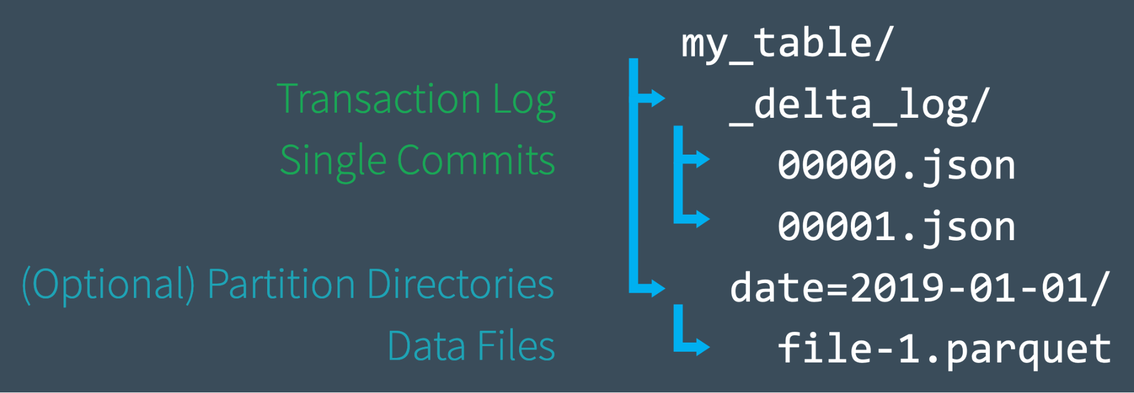
Delta transaction log at the file level
Notes:
When a user creates a Delta table, that table’s transaction log is automatically created in the _delta_log subdirectory. As he or she makes changes to that table, those changes are recorded as ordered, atomic commits in the transaction log.
In this image, we see two transactions recorded in the _delta_log and a single parquet file, partitioned by date.

Slide 36
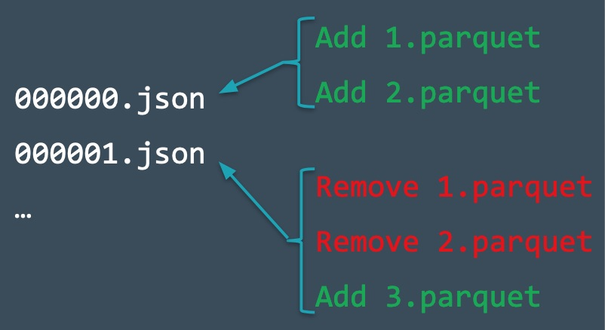
Adding commits to the transaction log
Notes:
Consider the following situation. We maintain our Delta table by the following transaction:
Add records to the table
from the data files 1.parquet and 2.parquet.
The transaction added to the transaction log, saved to disk as commit 000000.json.
Remove those files and add a new file
from the data file 3.parquet.
These actions are recorded as the next commit in the transaction log, as 000001.json.
If we were to inspect the file in the file storage location, we would see all three files:
1.parquet
2.parquet
3.parquet
The transaction log is used to construct the current state of the Delta table when the table is queried. In this case, 000000.json and 000001.json would show that only 3.parquet should be read for the query.

Slide 37
Spark SQL DESCRIBE HISTORY command

Slide 38
DESCRIBE Command
DESCRIBE HISTORY Command
Returns the metadata of an existing table
Ex. Column names, data types, comments
Returns a more complete set of metadata for a Delta table
Operation, user, operation metrics
Notes:
The DESCRIBE Command
The DESCRIBE SQL command returns the metadata of an existing table (column names, data types, and comments).
The DESCRIBE HISTORY Command
The DESCRIBE HISTORY command returns a more complete set of metadata for a Delta table. Note that this command is only available for Delta tables queried using Databricks. This includes provenance information, including the operation, user, and so on, and operation metrics for each write to a table. Table History is kept for 30 days.
In this course, we will query the history of our Delta tables using the Python API and the following syntax:
from delta.tables import DeltaTable
deltaTable = DeltaTable.forPath(spark, pathToTable)
fullHistoryDF = deltaTable.history()
The results of this command are useful in that it allows us to see all commits performed on a table. We will use this function in this course to explore each of the commits we have made to the table.

Slide 39
Time Travel

Slide 40
Delta Lake Time Travel
Query an older snapshot of a Delta table
Re-creating analysis, reports or outputs
Writing complex temporal queries
Fixing mistakes in data
Providing snapshot isolation
Notes:
The Delta transaction makes possible a feature known as Delta Lake time travel. Delta Lake time travel allows you to query an older snapshot of a Delta table. Time travel has many use cases, including:
Re-creating analyses, reports, or outputs (for example, the output of a machine learning model). This could be useful for debugging or auditing, especially in regulated industries.
Writing complex temporal queries.
Fixing mistakes in your data.
Providing snapshot isolation for a set of queries for fast changing tables

Slide 41
Time Travel SQL syntax
SELECT * FROM events TIMESTAMP AS OF timestamp_expression SELECT * FROM events VERSION AS OF version
Notes:
A time travel query can be performed with SQL as follows:
SELECT * FROM events TIMESTAMP AS OF timestamp_expression
SELECT * FROM events VERSION AS OF version

Slide 42
Time Travel SQL syntax
SELECT * FROM events TIMESTAMP AS OF timestamp_expression
timestamp_expression can be:
String cast to a timestamp
Explicit timestamp cast
Date string
More complex time/date expressions available as of Databricks Runtime 6.6
Notes:
timestamp_expression can be any one of:
a string that can be cast to a timestamp, e.g.'2018-10-18T22:15:12.013Z'
an explicit timestamp cast, e.g. cast('2018-10-18 13:36:32 CEST' as timestamp)
a date string, e.g. '2018-10-18'
In Databricks Runtime 6.6 and above:
current_timestamp() - interval 12 hours
date_sub(current_date(), 1)
Any other expression that is or can be cast to a timestamp

Slide 43
Time Travel SQL syntax
SELECT * FROM events VERSION AS OF version
Version can be obtained from the output of DESCRIBE HISTORY events.
Notes:
version is a long value that can be obtained from the output of DESCRIBE HISTORY events

Slide 44
Time travel DataFrame syntax
df1 = ( spark.read .format("delta") .option("timestampAsOf", timestamp_string) .load("/mnt/delta/events") ) df2 = ( spark.read .format("delta") .option("versionAsOf", version) .load("/mnt/delta/events") )
Notes:
DataFrameReader options allow you to create a DataFrame from a Delta table that is fixed to a specific version of the table.

Slide 45
Time Travel @ Syntax
# table on 2019-01-01 00:00:00.000 spark.read.format("delta").load("/mnt/delta/events@20190101000000000") spark.read.format("delta").load("/mnt/delta/events@v123")
Notes:
Delta tables can also be queried using time travel via the @ syntax.

Slide 46
RESTORE @Syntax
RESTORE [ TABLE ] table_name [ TO ] time_travel_version
time_travel_version
{ TIMESTAMP AS OF timestamp_expression |
VERSION AS OF version }
Notes:
Delta tables can also be queried using time travel via the @ syntax.

Slide 47
RESTORE Examples
- Restore the employee table to a specific timestamp
> RESTORE TABLE employee TO TIMESTAMP AS OF '2022-08-02 00:00:00';
table_size_after_restore num_of_files_after_restore num_removed_files num_restored_files removed_files_size restored_files_size
100 3 1 0 574 0
-- Restore the employee table to a specific version number retrieved from DESCRIBE HISTORY employee
> RESTORE TABLE employee TO VERSION AS OF 1;
table_size_after_restore num_of_files_after_restore num_removed_files num_restored_files removed_files_size restored_files_size
100 3 1 0 574 0
-- Restore the employee table to the state it was in an hour ago
> RESTORE TABLE employee TO TIMESTAMP AS OF current_timestamp() - INTERVAL '1' HOUR;
table_size_after_restore num_of_files_after_restore num_removed_files num_restored_files removed_files_size restored_files_size
100 3 1 0 574 0
Notes:
Delta tables can also be queried using time travel via the @ syntax.

Slide 48
Vacuum Table
VACUUM removes all files from the table directory that are not managed by Delta, as well as data files that are no longer in the latest state of the transaction log for the table and are older than a retention threshold. VACUUM will skip all directories that begin with an underscore (_), which includes the _delta_log. Partitioning your table on a column that begins with an underscore is an exception to this rule; VACUUM scans all valid partitions included in the target Delta table. Delta table data files are deleted according to the time they have been logically removed from Delta’s transaction log plus retention hours, not their modification timestamps on the storage system. The default threshold is 7 days.
VACUUM table_name [RETAIN num HOURS] [DRY RUN]
Notes:
Delta tables can also be queried using time travel via the @ syntax.

Slide 49
OPTIMIZE and Auto-OPTIMIZE

Slide 50
Data Housekeeping
OPTIMIZE for increased read performance
Delta optimization is about merging small file writes into larger chunk files for efficient querying on the tables
Delta optimization should be scheduled in off-load hours to avoid any impact on running processes.
Scheduling optimization depends on a combination of 2 factors :
Data Write frequency
Data Read frequency
Optimization can be scheduled :
Every few hours : Data is written very frequently and read continuously ( in interval of minutes )
Daily : Data is written 1-4 times daily and read very frequently ( in interval of minutes )
Weekly : Data is written once a week and read very frequently
Scheduled optimization is clubbed with z-order as well to help co-locate data for z-ordered columns in merged files.
Target File Size: ~1GB (default) good for typical use cases.
Go with smaller size (64MB - 128MB) when doing MERGE (to reduce amount of data read.)

Slide 51
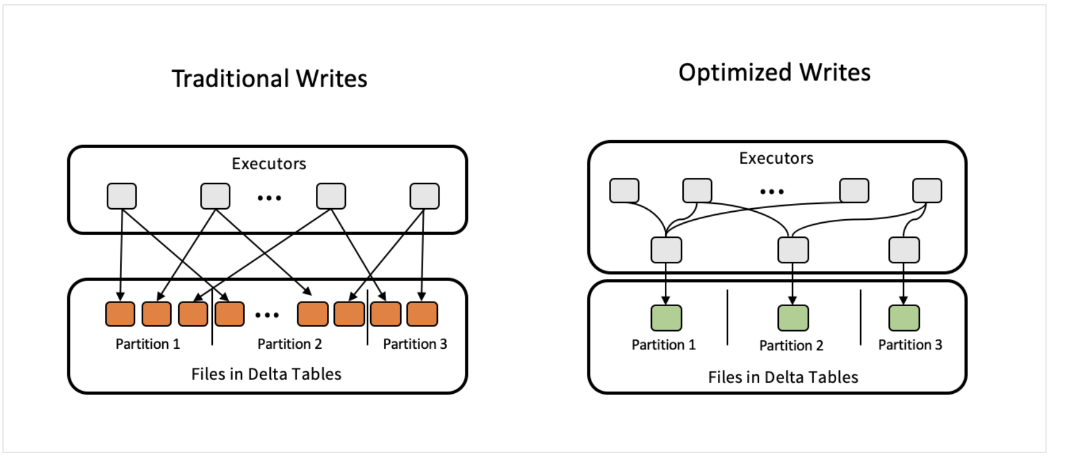
Data Housekeeping
AUTO-OPTIMIZE
Optimize write: Databricks dynamically optimizes partition sizes based on the actual data, and attempts to write out approx 128 MB files for each table partition.
Set config delta.autoOptimize.optimizeWrite = true while table creation or alter table to enable optimize write.
Auto Compaction: Databricks checks if files can further be compacted, and runs an OPTIMIZE job to further compact files for partitions that have the most number of small files.
Set config delta.autoOptimize.autoCompact = true while table creation or alter table to enable optimize write.

Slide 52
Databricks Workflows

Slide 53
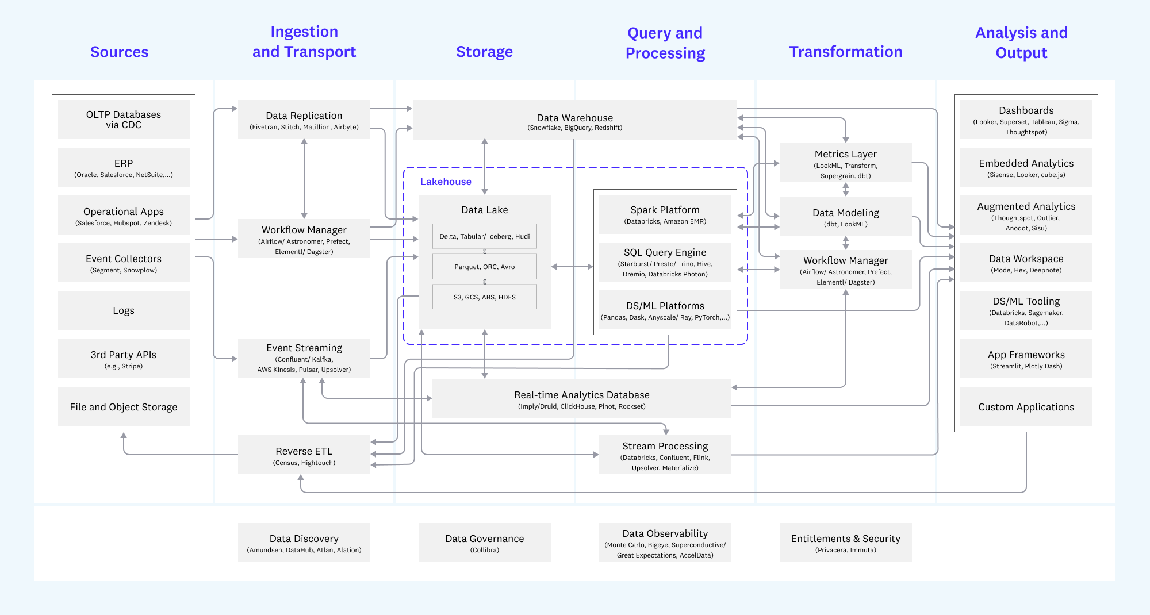
Workflows - Key part of data architectures

Slide 54
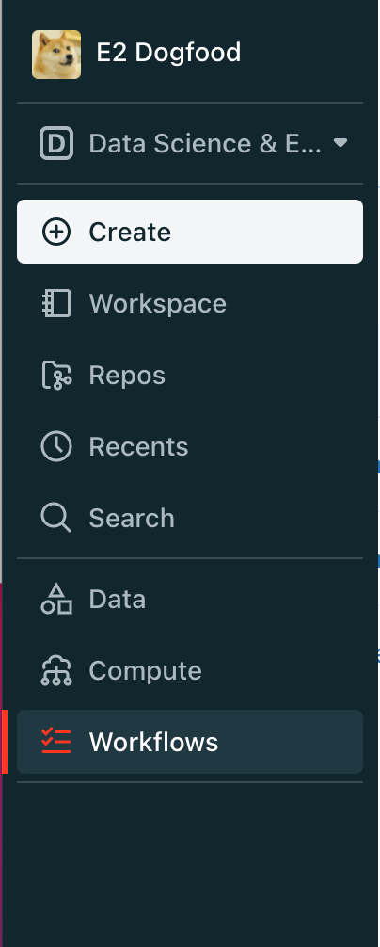
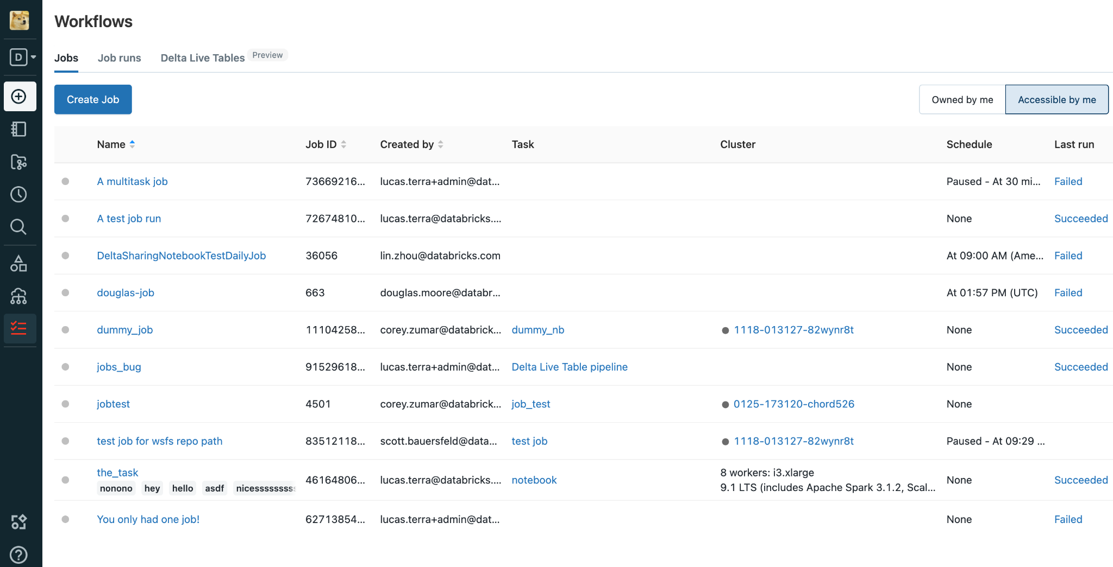
Workflows in Databricks Workspace

Slide 55





Orchestrate the Databricks Lakehouse
Lakehouse Platform
Data
Warehousing
Data Engineering
Data Streaming
Data Science
and ML
Databricks Workflows
Unity Catalog Fine-grained governance for data and AI
Jobs
Workflows (DAGs) for every task. Notebooks, Python, Databricks SQL, DLT, dbt, ML & more.
Delta Lake
Data reliability and performance
Cloud Data Lake
Delta Live Tables
Automated Pipelines, Data Quality and Lineage for Delta Lake.
All structured and unstructured data
Notes:
Databricks Workflows is the best way to Orchestrate the Lakehouse. Databricks workflows consists of 2 products/features. Jobs and Delta Live Tables
Jobs allow you build Workflows (a.k.a DAGs) for every task in the lakehouse including Notebooks, Photon, Databricks SQL, DLT, dbt, ML & more.

Slide 56
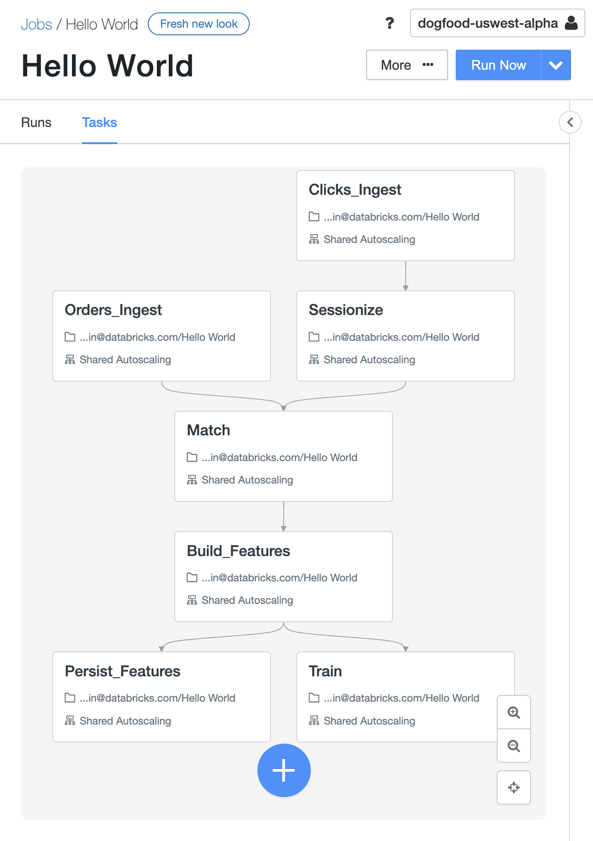
Jobs in Databricks Workflows
What is it? Easy creation, scheduling, and orchestration of your code with a DAG (Directed Acyclic Graphs)
Key features
Simplicity: Easy creation and monitoring in the UI
Many Tasks types suited to your workload
Fully integrated in Databricks platform, making inspecting results, debugging faster
Reliability of proven Databricks scheduler
Observability to easily monitor status
Job
DAG of tasks

Slide 57
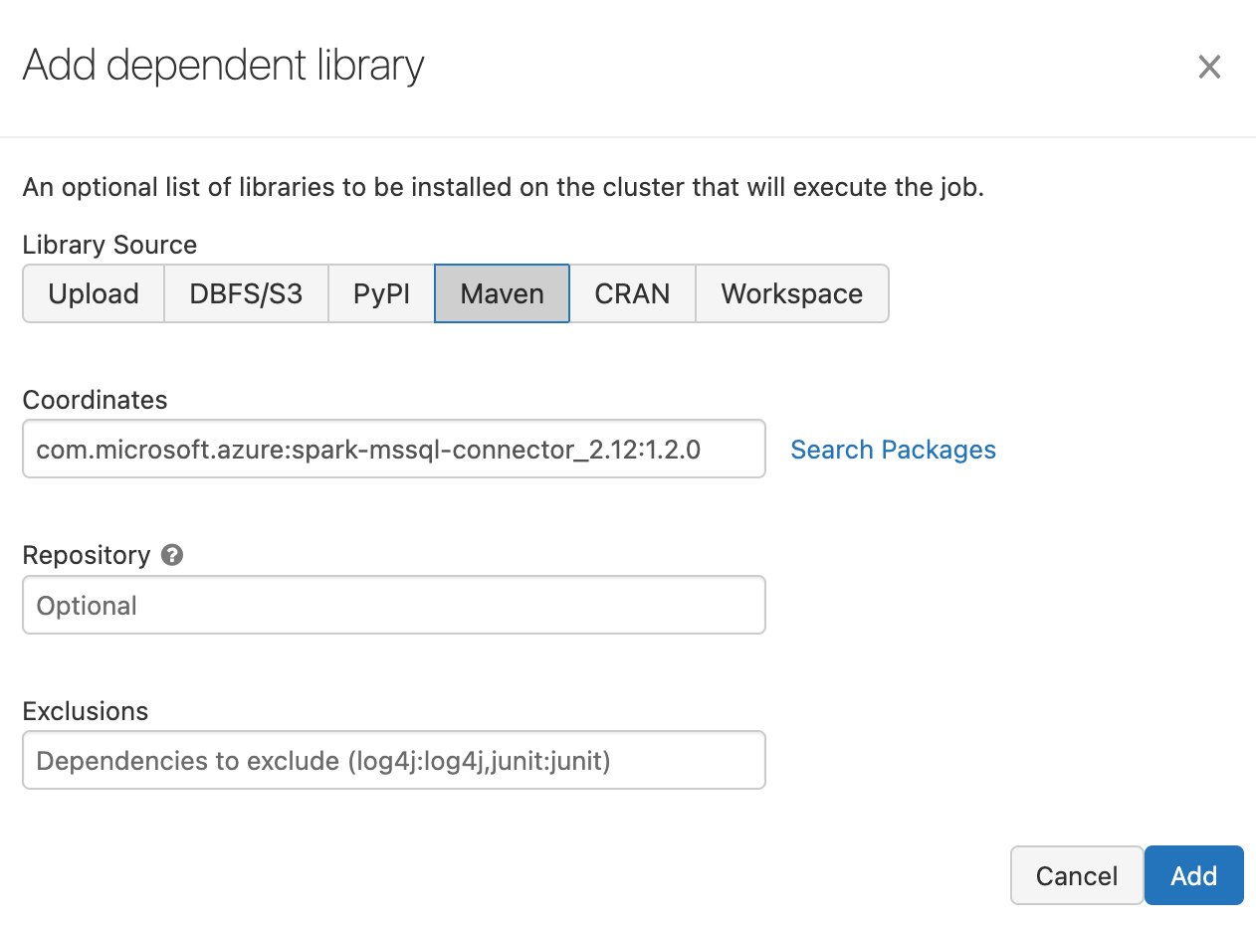
Databricks Jobs Example
Job (DAG) with Notebook, DLT and Python wheel tasks
Databricks clusters with custom libraries
Copy Customers From SQLServer
Notebook
Copy Orders From SQLServer
Notebook
Copy Regions From SQLServer
Notebook
Create Star Schema Model
Delta Live Tables
Power BI Update Dataset
Python Wheel

Slide 58
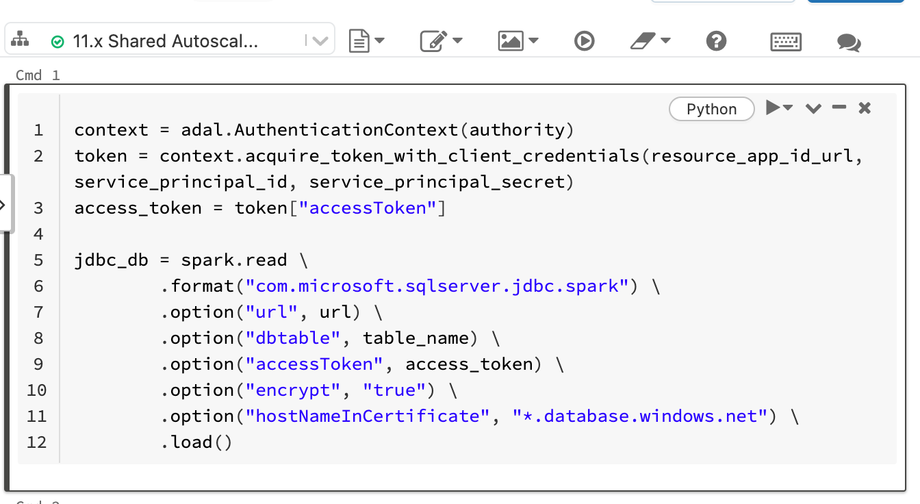
Databricks Jobs Example
Job (DAG) with Notebook, DLT and Python wheel tasks
Databricks Notebooks (Python, SQL or Scala)
Copy Customers From SQLServer
Notebook
Copy Orders From SQLServer
Notebook
Copy Regions From SQLServer
Notebook
Create Star Schema Model
Delta Live Tables
Power BI Update Dataset
Python Wheel
Notes:
https://docs.microsoft.com/en-us/sql/connect/spark/connector?view=sql-server-ver15

Slide 59
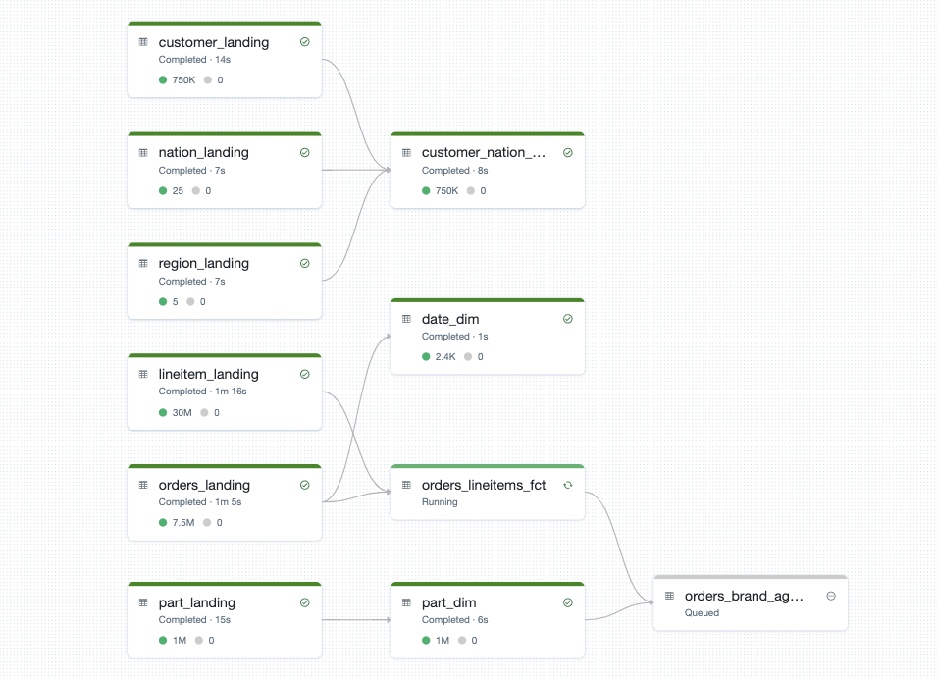
Databricks Jobs Example
Job DAG with Notebook, DLT and Python wheel tasks
Copy Customers From SQLServer
Notebook
Copy Orders From SQLServer
Notebook
Copy Regions From SQLServer
Notebook
Delta Live Tables pipeline (Triggered mode)
Create Star Schema Model
Delta Live Tables
Power BI Update Dataset
Python Wheel

Slide 60
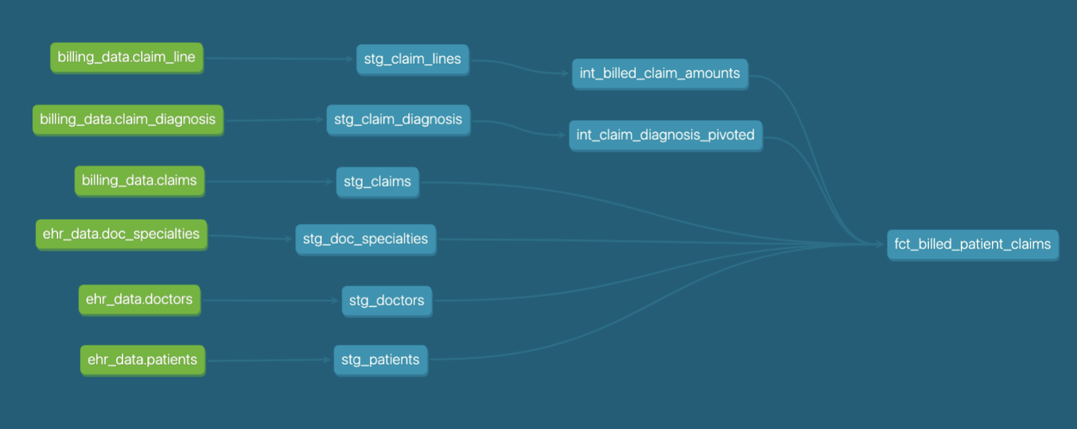
Databricks Jobs Example
Job DAG with Notebook, dbt and Python wheel tasks
Copy Customers From SQLServer
Notebook
Copy Orders From SQLServer
Notebook
Copy Regions From SQLServer
Notebook
dbt pipeline
Create Star Schema Model
dbt
Power BI Update Dataset
Python Wheel

Slide 61
Databricks Jobs Example
Job DAG with Notebook, dbt and Python wheel tasks
Copy Customers From SQLServer
Notebook
Copy Orders From SQLServer
Notebook
Copy Regions From SQLServer
Notebook
Python wheel with API Call to Power BI Datasets
import requests
r = requests.get('https://docs.microsoft.com/en-us/resGET https://api.powerbi.com/v1.0/myorg/groups/{groupId}/datasets/{datasetId}/refreshes?$top={$top}', auth=('user', 'pass'))
r.status_code
Create Star Schema Model
dbt
Power BI Update Dataset
Python Wheel

Slide 62
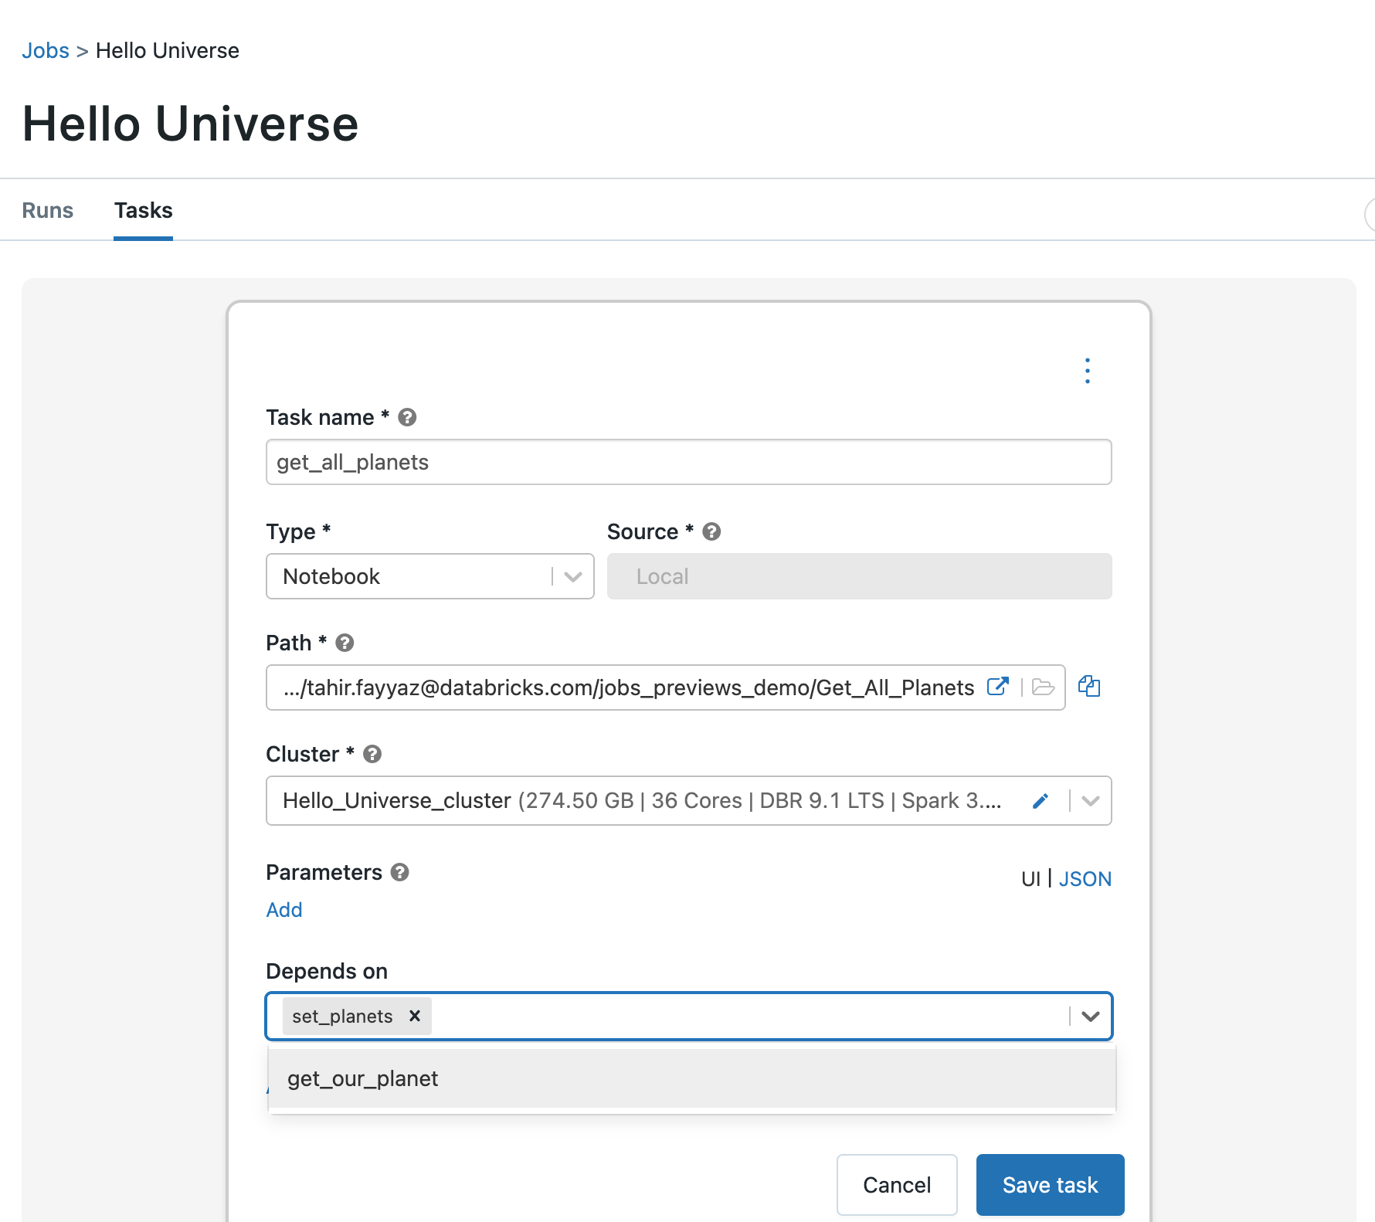
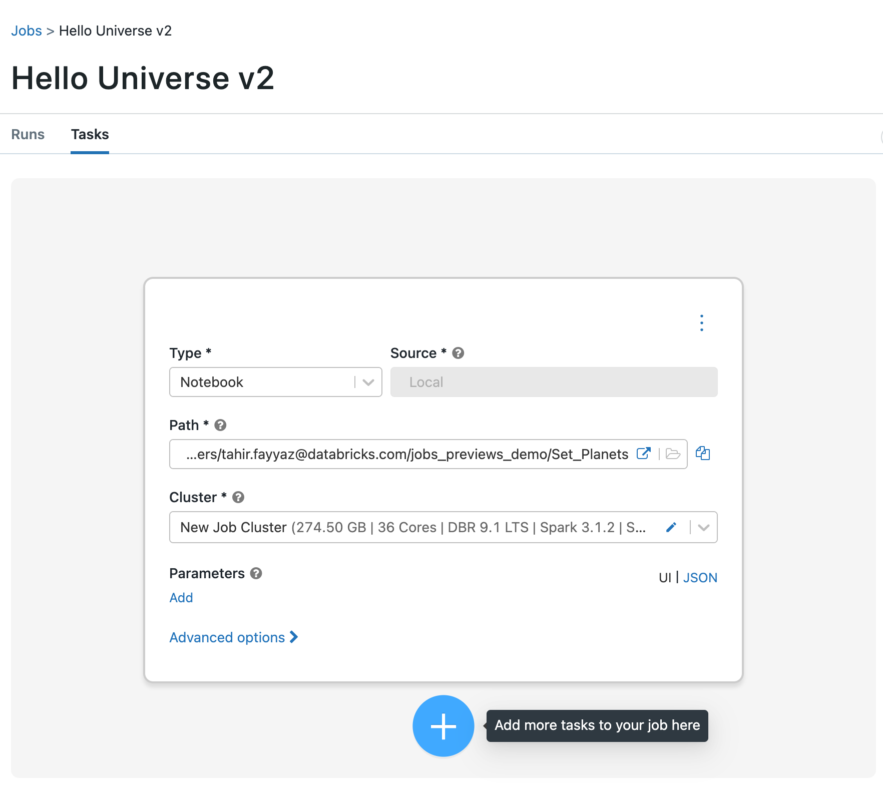
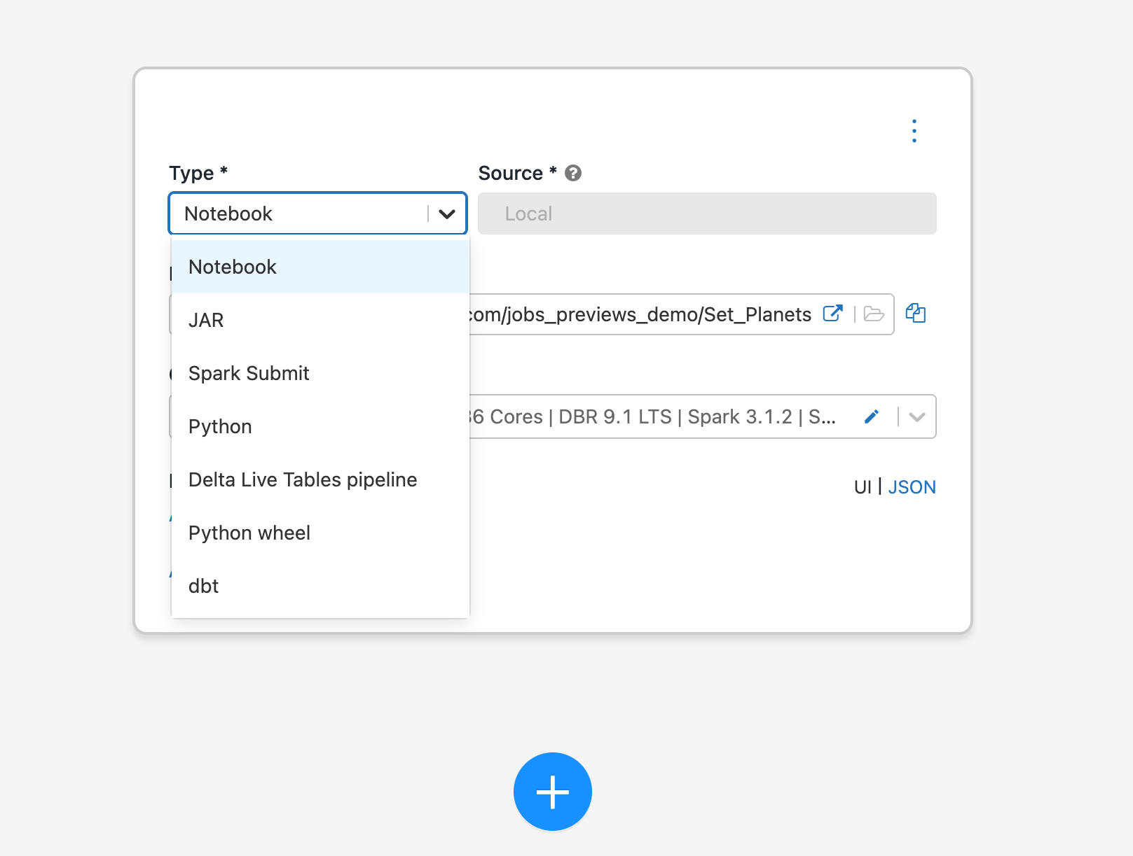
Creating Jobs with Multiple Tasks
Choose a task type from:
Notebook
Jar
Spark Submit
Python
Delta Live Tables
Python Wheel
dbt
Databricks SQL (Coming Soon)

Slide 63
Creating Jobs with Multiple Tasks
Create your first task and then add more tasks to the job

Slide 64
Creating Jobs with Multiple Tasks
Set dependencies between the tasks

Slide 65
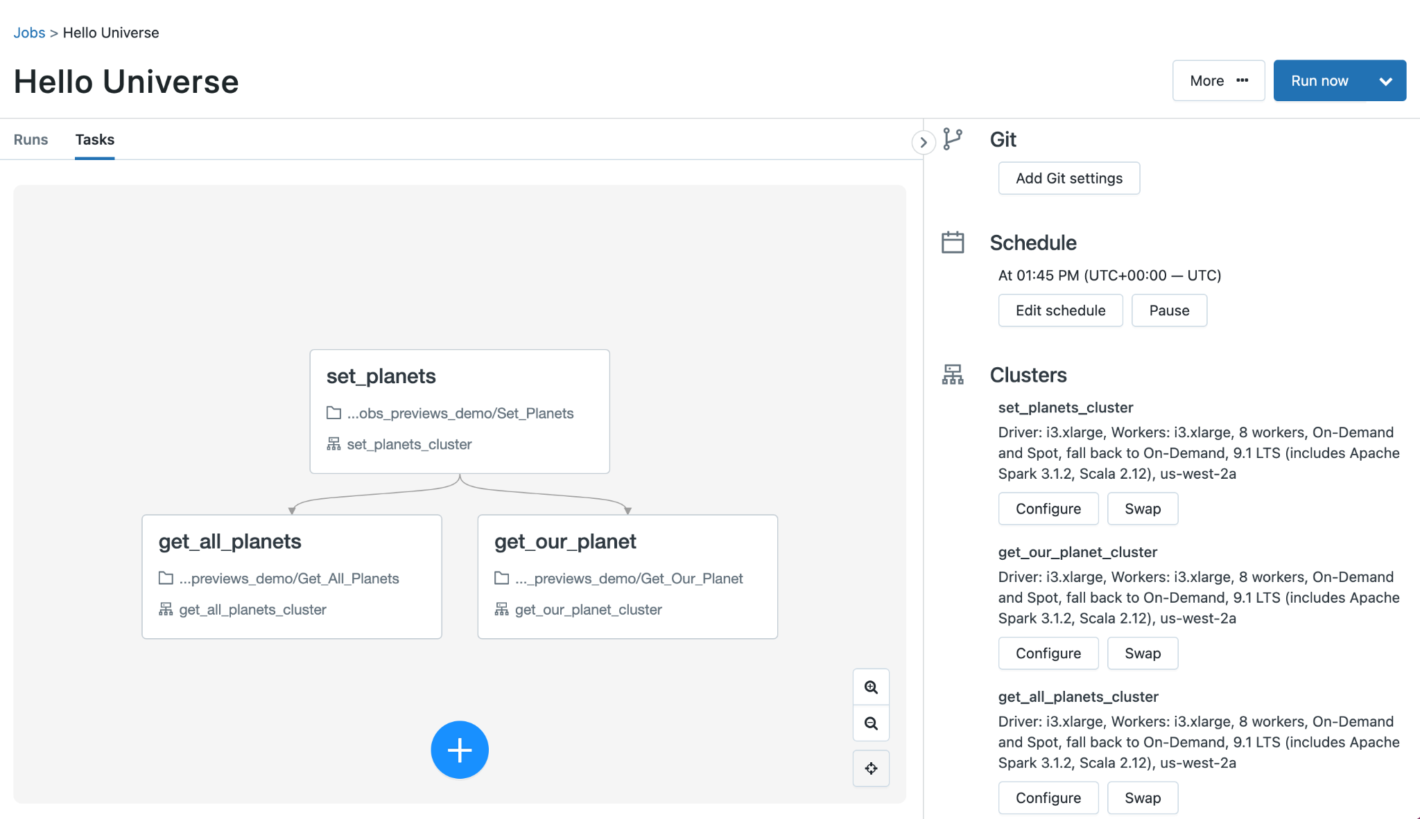
Creating Jobs with Multiple Tasks
Notes:
And you now have a job with multiple tasks

Slide 66
Open API for other orchestration tools
"name": "Silver table constructor",
"max_concurrent_runs": 1,
"tasks": [
{
"task_key": "filter",
"description": "Removes duplicates from the data",
"notebook_task": { "notebook_path": "/Shared/remove_dupes" },
"existing_cluster_id": "1201-team-shark"
},
{
"task_key": "GDPR",
"description": "Removes sensitive GDPR user data from the bronze input tables",
"depends_on": [{"task_key": "filter"}],
"notebook_task": { "notebook_path": "/Users/Shared/aggregate" },
"existing_cluster_id": "1201-team-shark"
},
Azure Data Factory
Airflow
[Bring your own]
Jobs API
Workflows UI for runs, history, etc.

Slide 67
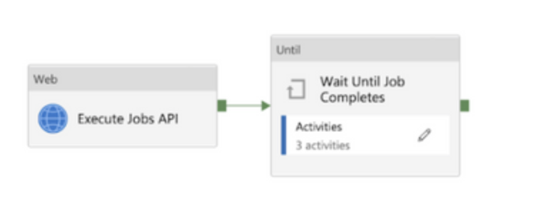
Integration with ADF
Databricks workflows or DLT comes with open rest API’s that can be integrated with ADF or other workflow orchestration tools :
Run now API : which returns a run ID which can be integrated with ADF as ADF Web activity.
Run Get API: which returns status of job using “run ID” captured in Step 1 ,which can be looped in “wait until” activity with some time lag until we get Success/Failure. This is done using Run Get “ADF Web Activity” in coalition with “ADF Until Activity”
Details can be referred here.
ADF
Run Now API + ADF Web Activity
Databricks Job 1
Databricks Job 2
Databricks Job 3
Databricks Workflows

Slide 68
Databricks Workflows Key benefits
Helps in cluster reuse in different tasks of workflow for already orchestrated job cluster ,helps to save costs
Helps in easy debugging , monitoring and alerting with no context switching ,everything available in a single screen.
Helps with advanced “repair and run” option for failed tasks of a workflow ,which allows user to run a particular failed task and its dependent tasks rather than complete flow.

Slide 69
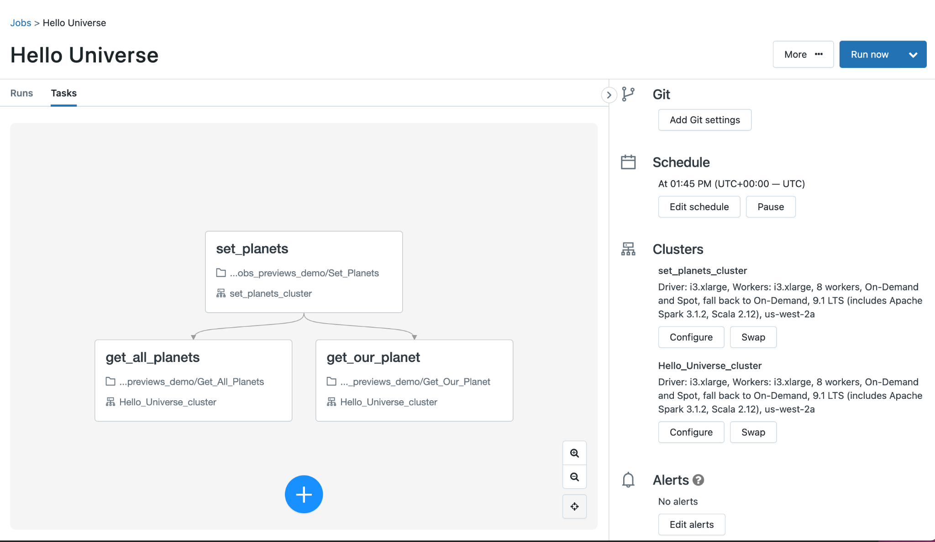
Databricks Jobs Cluster Reuse
Notes:
You define the cluster per task which means you can have 1 task using 1 cluster and then the 2 other tasks using another cluster.
You cannot re-use clusters across different jobs

Slide 70
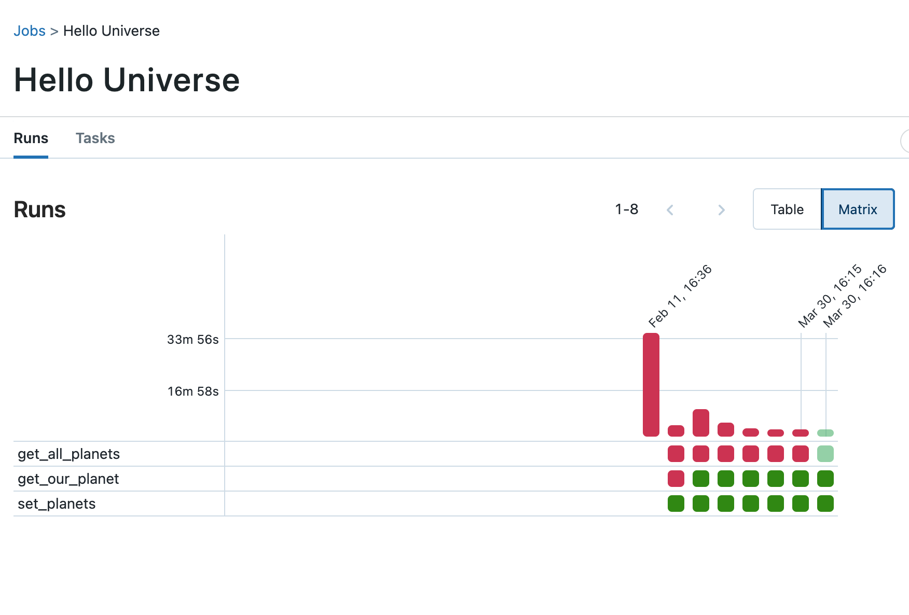
Monitor Jobs with Multiple Tasks

Slide 71
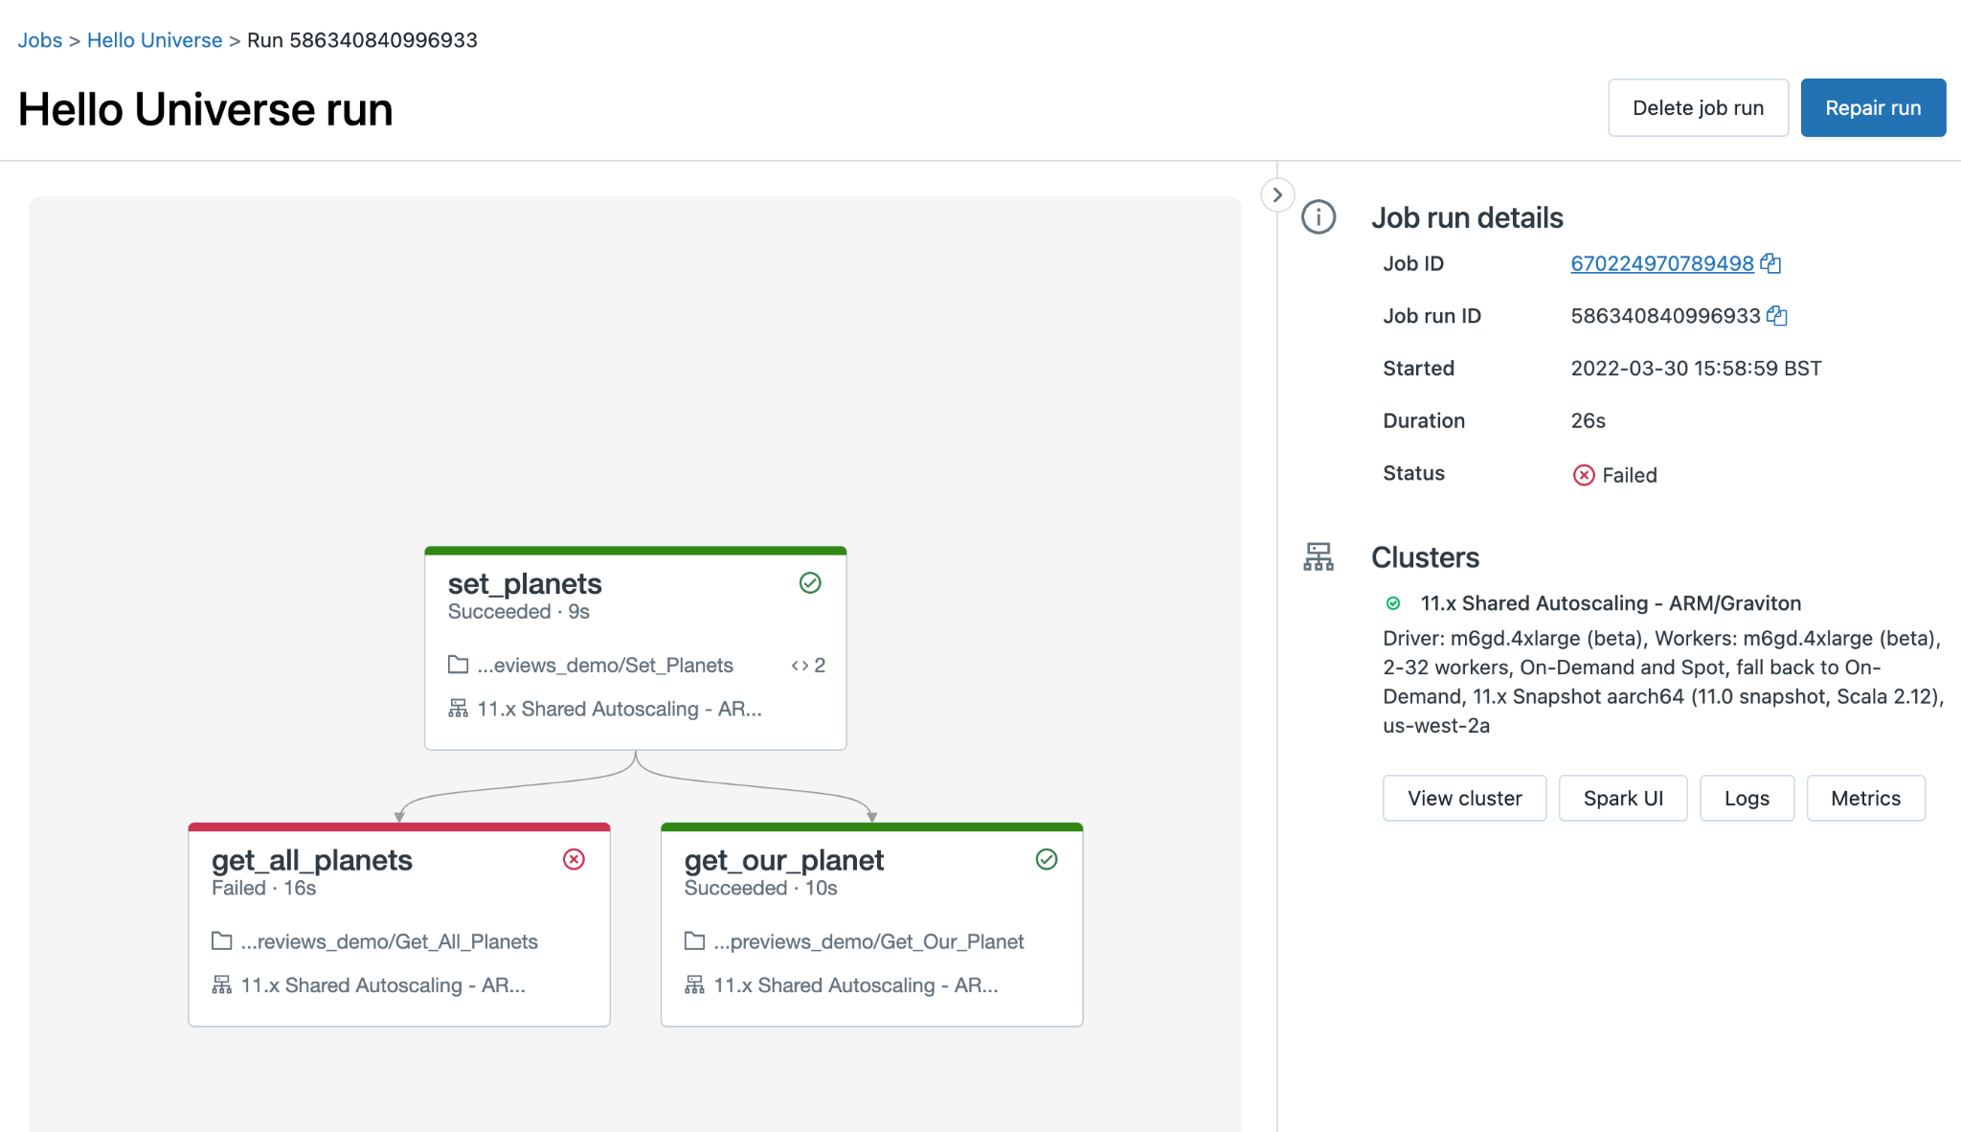
Databricks Jobs Repair & Rerun
Private Preview

Slide 72
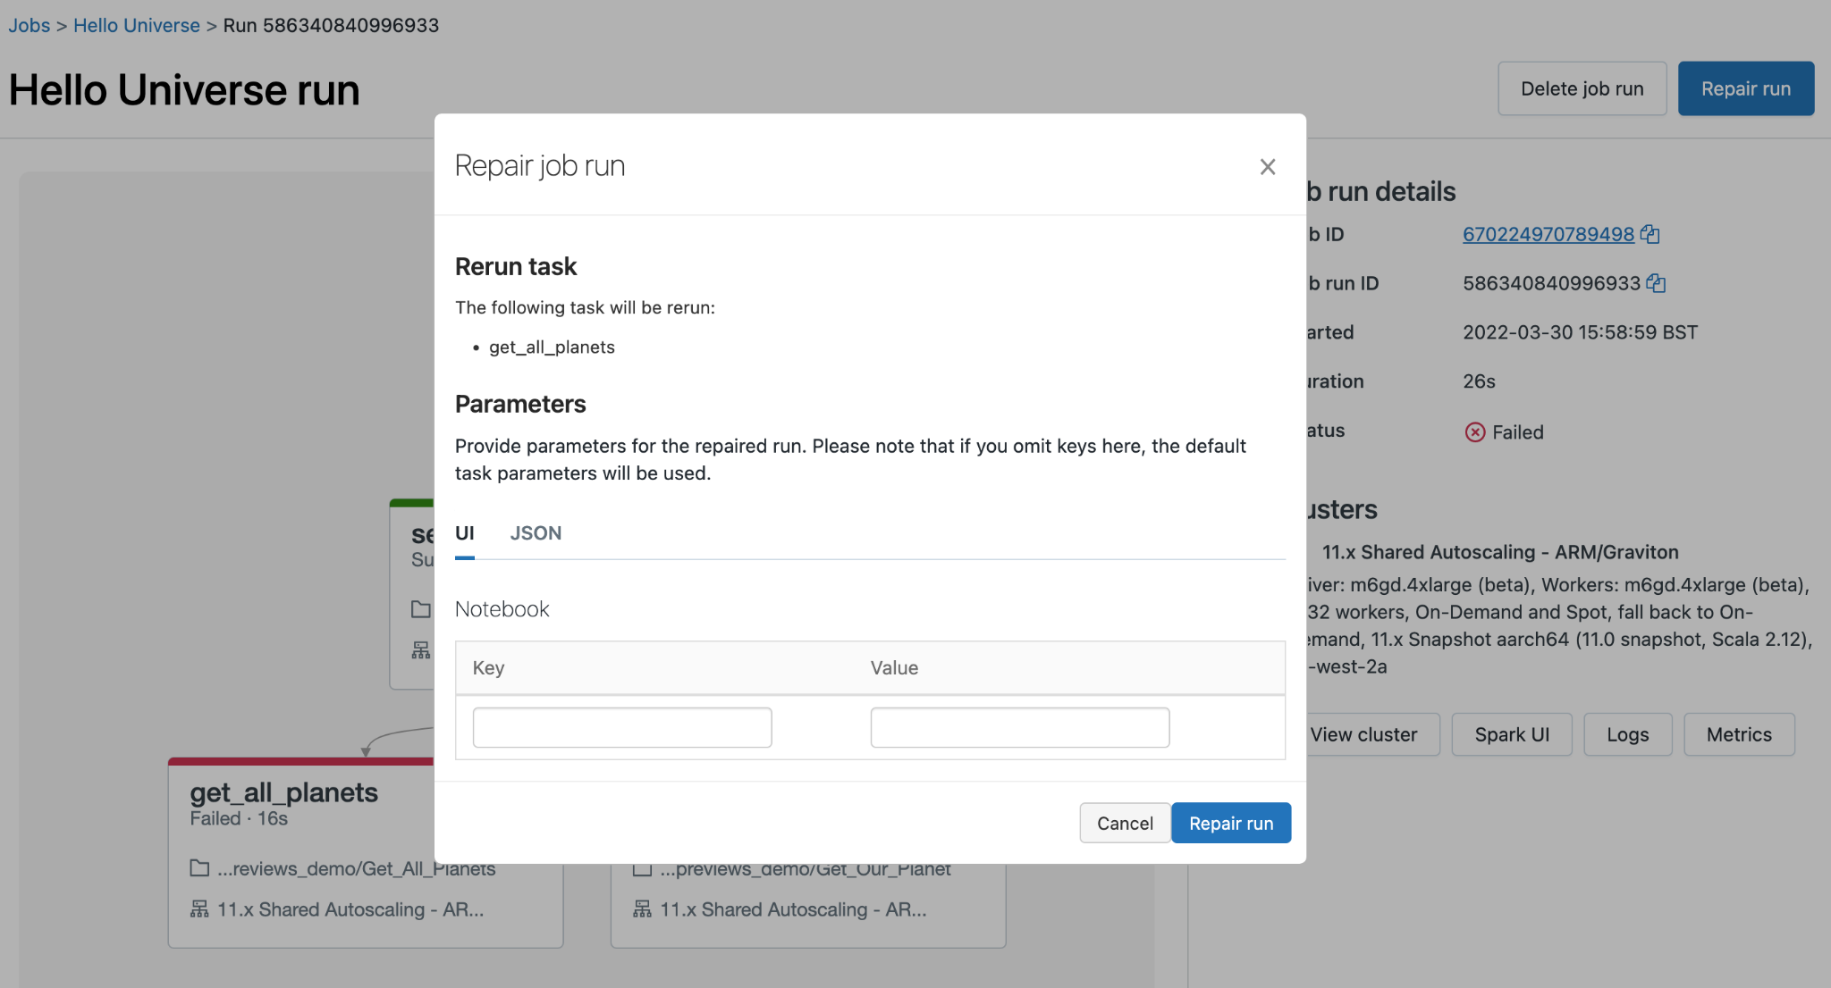
Databricks Jobs Repair & Rerun
Private Preview

Slide 73
Databricks Task Values
Sets a task value on the current task run:
dbutils.jobs.taskValues.set(key: String, value: Object)
Returns the latest task value for a previous task that belongs to the current job run:
dbutils.jobs.taskValues.get(taskKey: String, key: String, default: Option, debugValue: Option)

Slide 74
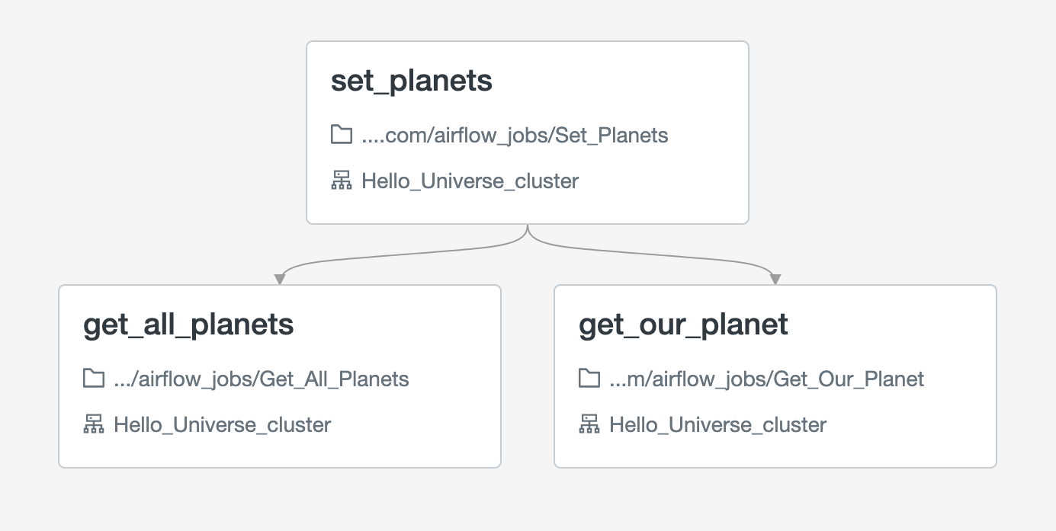
Databricks Task Values Examples
Set the task values in the first task
dbutils.jobs.taskValues.set(key="our_planet", value="Earth")
dbutils.jobs.taskValues.set(key="all_planets", value=["Earth", "Mars", "Saturn"])

Slide 75
Databricks Task Values Examples
Get the task values in the follow-up tasks
dbutils.jobs.taskValues.get(taskKey="set_planets", key="all_planets",
debugValue=["Earth", "Mars", "Saturn"])
dbutils.jobs.taskValues.get(taskKey="set_planets", key="our_planet",
default="Earth")

Slide 76
Databricks Workflow Vs ADF
Features | Databricks Jobs | Azure Data Factory
Manage everything in Databricks Lakehouse | Yes | No
Create Databricks cluster reuse job | Yes | No
Run Databricks cluster reuse job | Yes | Partial - Web Activity
View Databricks job’s tasks and dependencies | Yes | No
Multi-cloud | Yes | No (Azure Only)
Create DAG - GUI | Yes | Yes
Create DAG - API | Yes | Yes
Templated connectors / Ingestion | Partial - Spark Connectors | Yes
Scheduling | Yes | Yes
Triggers | No | Yes

Slide 77
Autoloader
Automate Lakehouse Ingestion

Slide 78


Current Challenges
Data Ingestion from Cloud Storage
Schema On Read
Loading data to Delta Lake from cloud files requires complex cloud architecture and custom handling to ensure that newly-arriving data is read once, and only once, into the platform.
Source data schemas may change at any time. Updates to the schema during stream processing can break loading scripts, leaving data out of date or corrupt, and missing SLAs.
Notes:
Data Ingestion from Cloud Storage
Requires advanced cloud architecture knowledge to set up the requisite resources and connectivity for processing files in this manner
In order to ensure that all data is processed and to avoid duplicate processing, data engineers must configure complex logic leveraging costy listing procedures.
Difficult to ensure completeness
Schema on Read
Setting up ingestion usually requires detailed knowledge of the incoming schema. This is not always available.
Further, schemas may change over time, especially in semi-structured formats. When this happens, processing may error, leaving data in invalid states, or drop new fields leading to data loss.

Slide 79
What Auto Loader Does For You
Auto-ingest new files
Scalable to billions of files
Infer & evolve Schemas
Easily get started
Incrementally process new files as they land in cloud object storage without costly file listing procedures or state information handling
Auto Loader configures cloud notification and message queues to ensure that all files are sent to be ingested as they land and can scale to billions of file per directory
Identify schema on initialization and detect changes over time from structured sources and semi-structured data formats
Add hints for enforcement where some schema is known
Easy to deploy and easy to use with automated deployment of services making Auto Loader nearly set and forget
Notes:
Rearrange to have Easy to Get Started first, then Auto-Ingest, then Infer & Evolve, then Scalable
** Capture unparsed data to avoid info loss

Slide 80

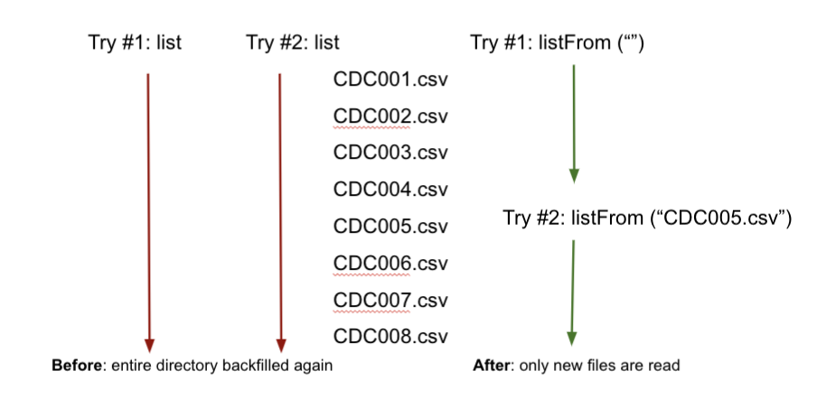
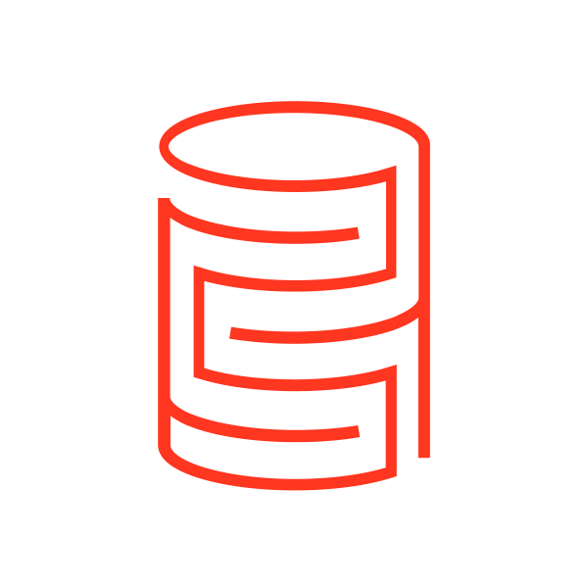

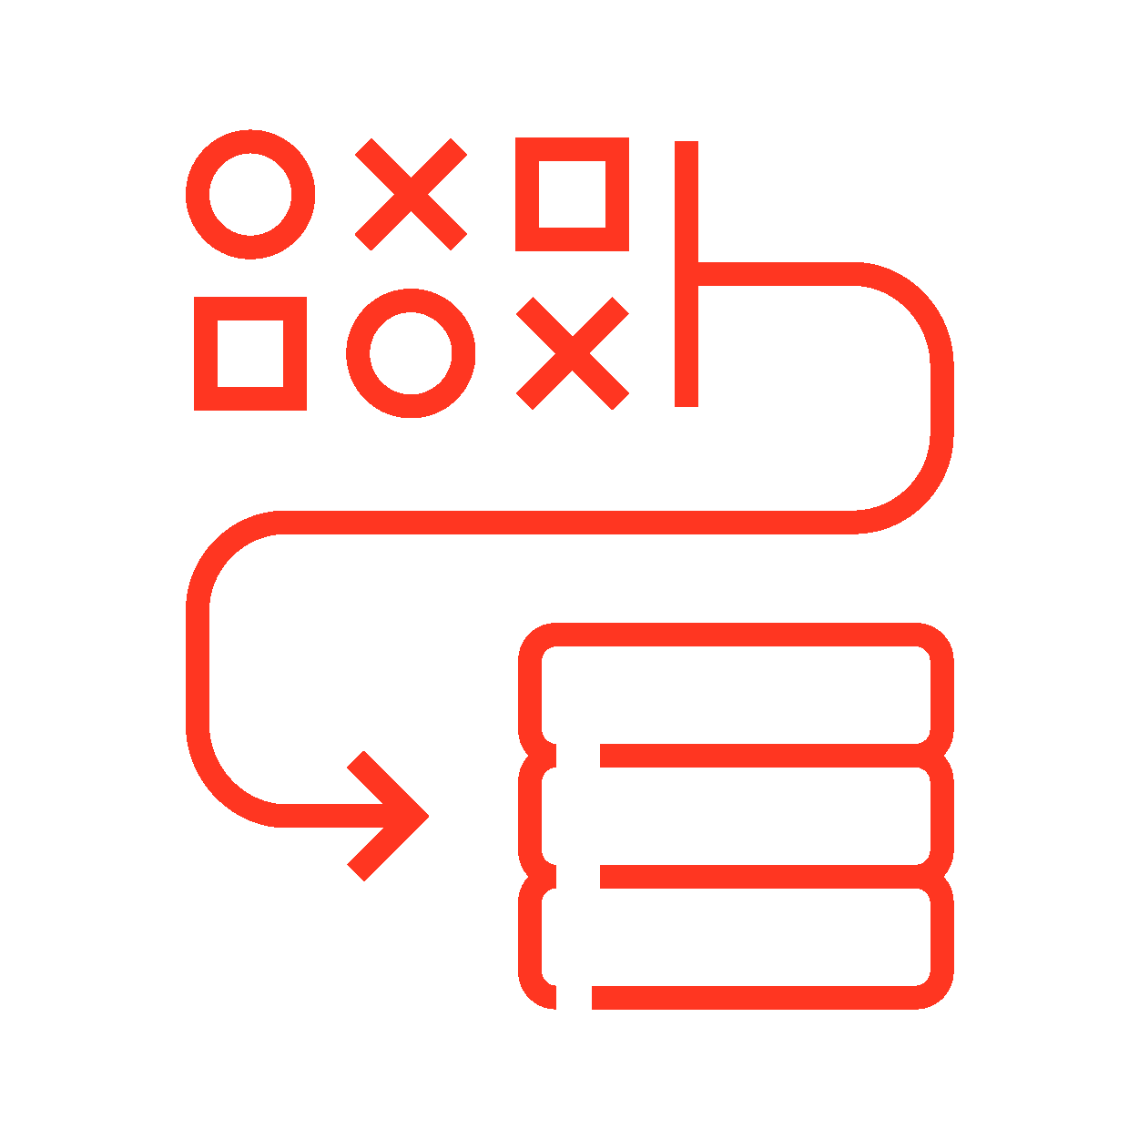
Auto Loader: Faster, smarter, and easier
Autoloader now supports schema evolution and much faster incremental listing mode
Incremental listing mode - simplicity of directory listing with performance of notification mode
Automatically infer schema of incoming files
Schema Hints - superimpose what you know on automatic inference
Automatically add new columns
Notes:
1. Aha feature (if applicable):
Auto Loader Improvements: Aha file ingestion, security setup, schema inference
2. Description and value of the feature (aka what databricks was before this feature, and what this feature will do for databricks):
AutoLoader is an efficient way to bring data into Delta Lake in a streaming fashion
Incremental listing mode:simply list from the last filename we have processed so as to only capture the new files. Directory listing doesnt require any set but it relist the directory entirely and can take time at stream start time. Notification mode solves this issue by listening to only new files but messages may expire and customers have to go to an extra step to set it up. Now with incremental listing (which will be default mode in autolaoder) you get simplicity of directory listing with performance of notification listing mode
Auto Loader now supports automatic schema inference at stream start for all file formats.
Customers can also augment automatic inference with schema hints to set the table structure of your choice.
When ingesting JSON data, Auto Loader can now detect schema changes and separate out data or even entire columns that do not conform to the current schema (rescued data column) in additional unparsed columns without failing the ingestion jobs.
Customers can combine these new Auto Loader capabilities with Databricks jobs to automatically evolve schemas as the stream changes between micro-batches without causing interruptions.
Auto Loader will infer the schema of the incoming files (today users have to manually specify the schema).
In the real-world we often see files change their structure over time - new field appear or are missing. Auto Loader now will infer schemas of the arriving files and automatically handle changes in their schemas from the original
3. Fill out the following template for the feature(s) described on this slide
Choices: supported, not planned, planned insert quarter*
AWS E2: Incremental listing mode (Planned, Q2), everything else supported LEGACY [ST:, PVC:] Incremental listing mode (Planned, Q2), everything else supported
Azure E2: Incremental listing mode (Planned, Q2), everything else supported GFM [Gov , China]: planned
GCP E2 : Incremental listing mode (Planned, Q2), everything else supported
*future dates are subject to change

Slide 81



Auto Loader: Faster, smarter, and easier
Autoloader has dozens of out of the box features required for ETL
Rescue data column - never lose data again
Streaming or in Batch - easy to switch from batch to streaming and vice versa
Detect Schema changes - get notification when schema is changed from the source.

Slide 82


Schema inference and evolution
Autoloader is suitable for flexible semi-structured data pipeline
Partition - automatically create partition based on source directory structure
Schema inference - no need to specify a schema input for json and csv data, multiple ways to set sample data for schema inference.
Time travel for schema changes - navigable history of schema changes
Notes:
Autoloader

Slide 83
Two Ways to Use Auto Loader
Directory Listing Mode
File Notification Mode
Default mode
Easily stream files from object storage without configuration
Creates file queue through parallel listing of input directory
Good for smaller source directories & one time ingest of huge static directories
Uses cloud storage queue service and event notifications to track files
Configurations handled automatically by Databricks
Scales well as data grows

Slide 84
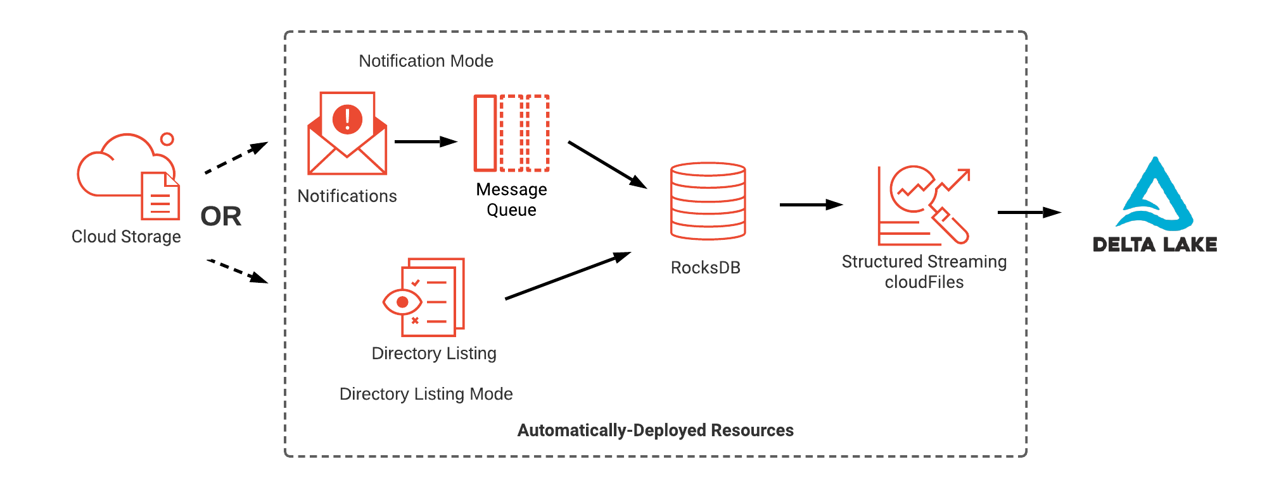
Auto Loader Under the Hood
.option(“cloudFiles.useNotifications”,“true”)
Notes:
The default behavior for Auto Loader is to use Directory Listing mode. This includes all subdirectories of the path indicated.
In this mode, files landing in cloud storage are listed in RocksDB to ensure deduplication and tracking of what has been processed. Only the path to the data is listed here, the contents of the file are not replicated into this database.
RocksDB is a persistent data store that is housed with the stream checkpoint information so that it can be re-instantiated as needed when clusters are shut down and restarted.
From RocksDB, any previously unprocessed data is listed to be part of the structured stream for Auto Loader to use.
The Directory Listing mode works well with relatively low velocity and volume of files
For larger volumes or higher velocity, the Notification Mode may be a better option. In this mode, file creation events trigger notifications that are sent to a message queue. The message queue is then sent to RocksDB, again to ensure deduplication and tracking of what has been processed.

Slide 85
Getting started with Auto Loader
Also Available in DLT
Load files from Cloud Storage , in Python or Scala
df = spark.readStream
.format("cloudFiles")
.option("cloudFiles.format", "json")
.load("/input/path")
.writeStream
.option("checkpointLocation","/chk/path")
.start("/out/path")

Slide 86
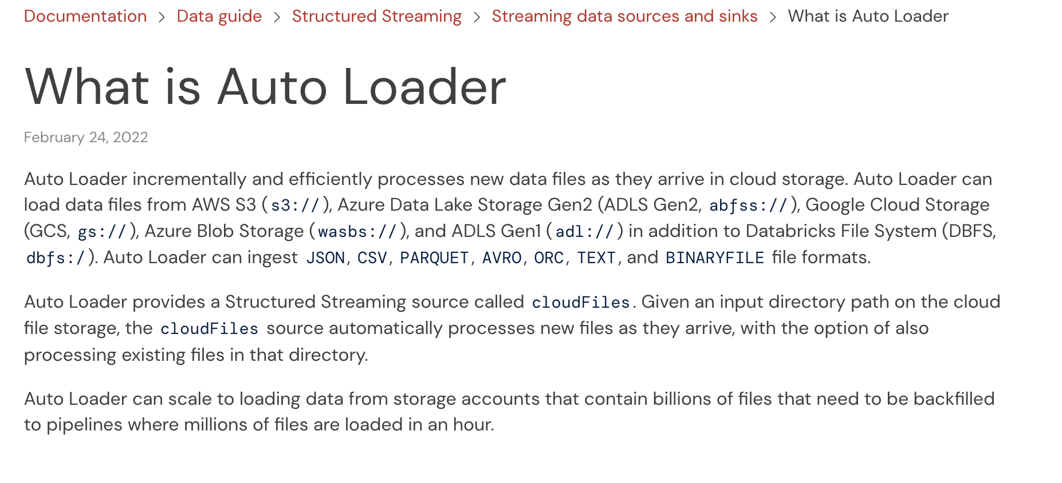
Learn more about Auto Loader
Documentation

Slide 87
Day 2 Closing - Q&A, Live Deployment in SC
14:00-16:00
Q&A (2 hrs):
Medallion Layer Architecture
Deep dive into ETL
Data pipeline Deep Dive :
DLT
Autoloader
Workflow

